Slide 1
20MCA16 - PROGRAMMING LOGIC AND DESIGN
Dr.B.Meenakshi Sundaram
Associate Professor
Department of MCA, NHCE

Slide 2
SYLLABUS
PROGRAMMING LOGIC AND DESIGN
Course Code | : 20MCA16 | Credits | :03
L:T:P | :2:1:0 | CIE Marks | :50
Exam Hours | : 3 | SEE Marks | :50

Slide 3
Course Outcomes
At the end of the Course, the Student will be able to:
CO1 | Understand the digital computer fundamentals and its basic operations
CO2 | Analyze the importance of algorithmic problem solving with examples
CO3 | Learn essential programming control structures
CO4 | Apply factoring methods and data structures to a variety of software applications
CO5 | Understand certain basic operations on essential data structures
CO6 | Use complex data types to model the real-world problems

Slide 4
UNIT-1
Binary Systems and Digital Computer Fundamentals: Number Systems, Digital Computers and Digital Systems, Binary, Octal and Hexadecimal Numbers, Number Base Conversion, subtraction using r’s and r-1 complements, Registers, Binary Logic, Digital Logic Gates – basics. Basic Elements of Von-Neumann model, Processor Registers, Instruction Execution, Interrupts, The Memory Hierarchy, Cache Memory, I/O Communication Techniques, and Virtual Memory.

Slide 5
UNIT-2
Introduction to Computer Problem-Solving Introduction – The Problem-Solving Aspect – Top-Down Design– Implementation of Algorithms – Program Verification – The efficiency of algorithms – The analysis of algorithms – Pseudo code, Structured English and Flowchart. Fundamental Algorithms Factorial Computation – Generation of the Fibonacci sequence and much more illustrations.

Slide 6
UNIT-3
Essential Programming Control Structures: Data Types and Input/output Operators, Operators and Expressions, Control Statements, Decision making and functions (pre-defined, user-defined).

Slide 7
UNIT-4
Problem Solving methods: Factoring Methods: Factoring Methods , Finding the square root of a number, Generating prime numbers. Array techniques: Array order reversal, Finding the maximum number in a set, Removal of duplicates from an ordered array, Finding the k^{th} smallest element. Strings and Pointers.

Slide 8
UNIT-5
Complex data types to solve problems: structures, union and user-defined data types: enum, typedef and FILE handling applications.

Slide 9
TEXT BOOKS
M. Morris Mano, “Digital Logic and Computer Design”, Pearson, 2012.
Programming Logic And Design, “Tony Gaddis”, Pearson, 2016, ISBN: 978-0-13-3985078.
R.G. Dromey, “How to solve it by Computers”, Pearson Publishers, New Delhi, 2007.
Joyce Farrell, Programming Logic & Design, CENGAGE learning, 9th Edition, 2018.

Slide 10
REFERENCE BOOKS
Peter Norton, “Introduction to Computers”, 4th Edition, TMH Ltd, New Delhi, 2001.
Carl Hamacher, Zvonko Vranesic Safwat Zaky, ”Computer Organization”, 5th edition, Tata McGraw-Hill, 2011.
V Rajaraman: Computer Programming in C, PHI, 2013.

Slide 11
UNIT-1
Binary Systems and Digital Computer Fundamentals: Number Systems, Digital Computers and Digital Systems, Binary, Octal and Hexadecimal Numbers, Number Base Conversion, subtraction using r’s and r-1 complements, Registers, Binary Logic, Digital Logic Gates – basics. Basic Elements of Von-Neumann model, Processor Registers, Instruction Execution, Interrupts, The Memory Hierarchy, Cache Memory, I/O Communication Techniques, and Virtual Memory.

Slide 12
DIGITAL COMPUTER FUNDAMENTALS
Overview
Introduction to Computers
Characteristics of Computers
History/Evolution
Generation Of Computers

Slide 13
Introduction To Computers
Definition:
Its an electronic Device that is used for information Processing.
Computer.. Latin word.. compute
Calculation Machine
A computer system includes a computer, peripheral devices, and software

Slide 14
Introduction To Computers
Accepts input, processes data, stores data, and produces output
Input refers to whatever is sent to a Computer system
Data refers to the symbols that represent facts, objects, and ideas
Processing is the way that a computer manipulates data
A computer processes data in a device called the central processing unit (CPU)

Slide 15
Introduction To Computers
Memory is an area of a computer that holds data that is waiting to be processed, stored, or output
Storage is the area where data can be left on a permanent basis
Computer output is the result produced by the computer
An output device displays, prints or transmits the results of processing

Slide 16
Introduction To Computers

Slide 17
Introduction To Computers
Computer
Performs computations and makes logical decisions
Millions / billions times faster than human beings
Computer programs
Sets of instructions for which computer processes data
Hardware
Physical devices of computer system
Software
Programs that run on computers

Slide 18
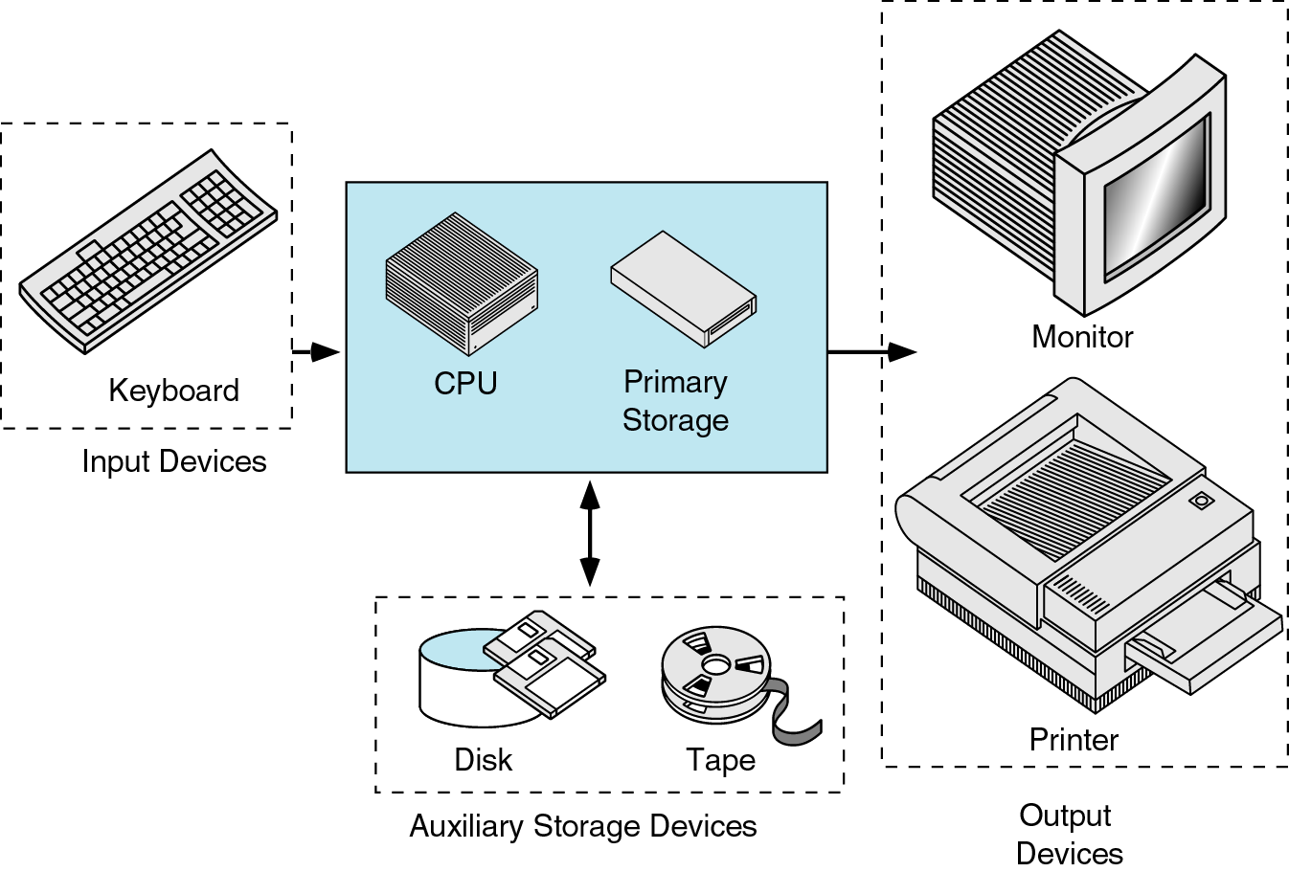
Definition:
Introduction To Computer Software
Operating system
Problem solving Techniques
Computer Prog ramming languages
Computer Threats

Slide 19
Introduction To Computers
Capabilities of Computers
Huge Data Storage
Input and Output
Processing

Slide 20
Introduction To Computers
Characteristics of Computers
High Processing Speed
Accuracy
Reliability
Versatility
Diligence

Slide 21
Introduction To Computers
History Of Computers

Slide 22
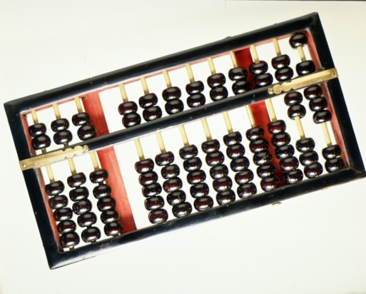
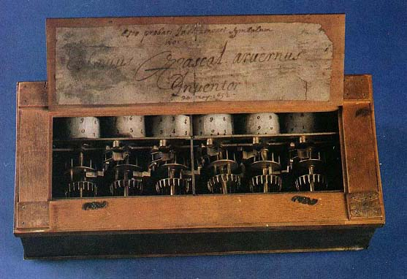
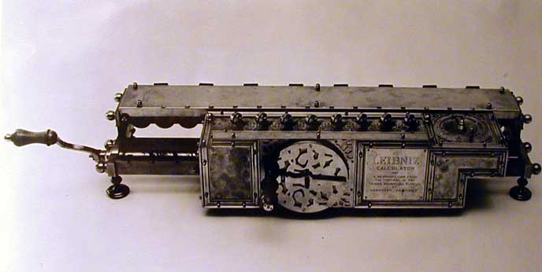
Before the 1500s, in Europe, calculations were made with an abacus
Invented around 500BC, available in many cultures (China, Mesopotamia, Japan, Greece, Rome, etc.)
In 1642, Blaise Pascal (French mathematician, physicist, philosopher) invented a mechanical calculator called the Pascaline
In 1671, Gottfried von Leibniz (German mathematician, philosopher) extended the Pascaline to do multiplications, divisions, square roots: the Stepped Reckoner
None of these machines had memory, and they required human intervention at each step

Slide 23
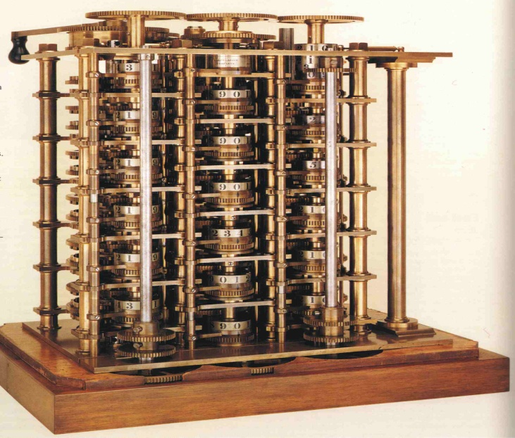
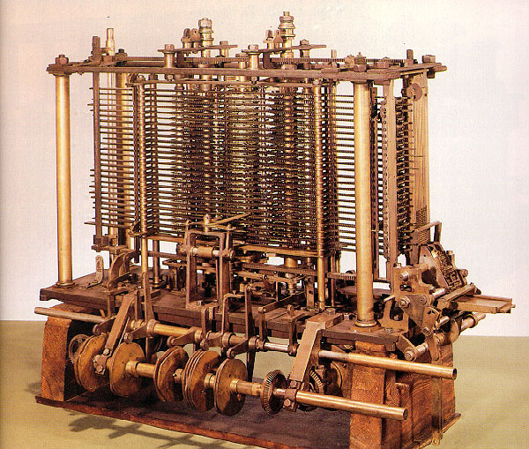
In 1822 Charles Babbage (English mathematician, philosopher), sometimes called the “father of computing” built the Difference Engine
Machine designed to automate the computation (tabulation) of polynomial functions (which are known to be good approximations of many useful functions)
Based on the “method of finite difference”
Implements some storage
In 1833 Babbage designed the Analytical Engine, but he died before he could build it
It was built after his death, powered by steam

Slide 24
Introduction To Computers
Generations of Computers

Slide 25
Introduction To Computers
Generation of Computers
First Generation (1946-59)
Second Generation(1957-64)
Third Generation(1965-70)
Fourth Generation(1970-90)
Fifth Generation(1990 till date)

Slide 26
Introduction To Computers
Generation 0: Mechanical Calculators
Generation 1: Vacuum Tube Computers
Generation 2: Transistor Computers
Generation 3: Integrated Circuits
Generation 4: Microprocessors

Slide 27
Introduction To Computers
 | First Generation | Second Gen. | Third Gen. | Fourth Gen.
Technology | Vacuum Tubes | Transistors | Integrated Circuits (multiple transistors) | Microchips (millions of transistors)
Size | Filled Whole Buildings | Filled half a room | Smaller | Tiny - Palm Pilot is as powerful as old building sized computer

Slide 28
Introduction To Computers
Some Pictures…..

Slide 29
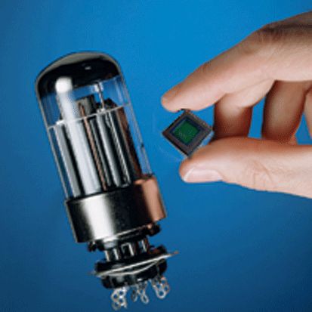

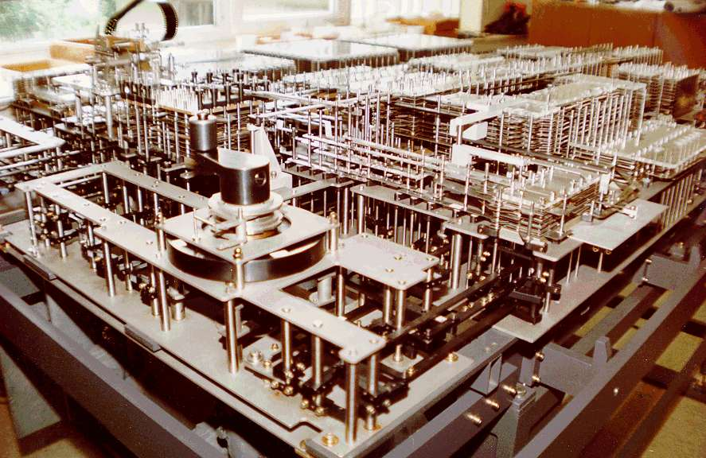
Generation 1 : ENIAC
The ENIAC (Electronic Numerical Integrator and Computer) was unveiled in 1946: the first all-electronic, general-purpose digital computer

Slide 30
The use of binary In the 30s Claude Shannon (the father of “information theory”) had proposed that the use of binary arithmetic and boolean logic should be used with electronic circuits The Von-Neumann architecture
CPU
Memory
I/O
System

Slide 31
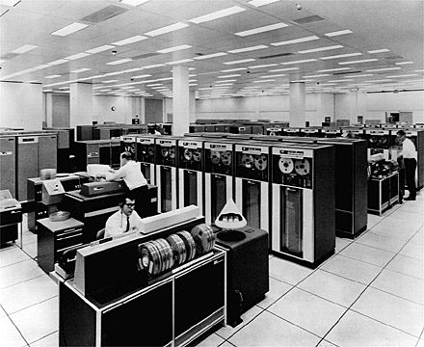
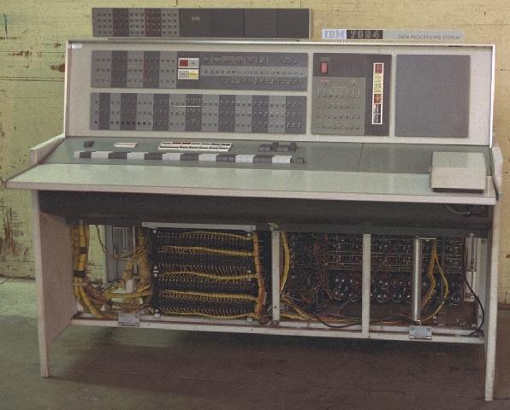
Generation 2: IBM7094

Slide 32
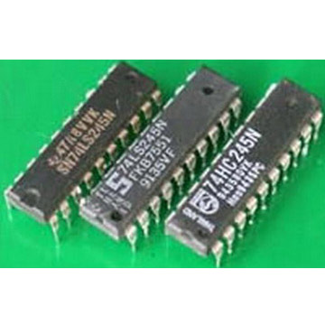
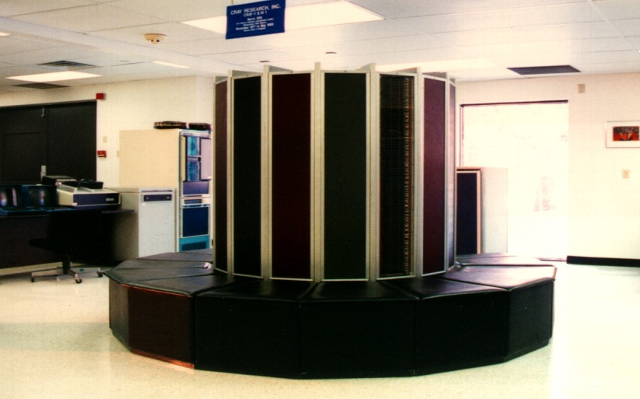
Generation 3: Integrated Circuits
Seymour Cray created the Cray Research Corporation
Cray-1: $8.8 million, 160 million instructions per seconds and 8 Mbytes of memory

Slide 33
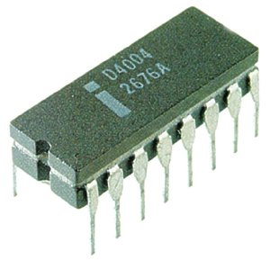
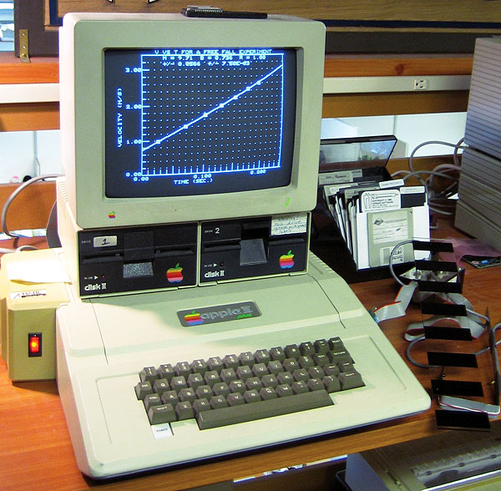
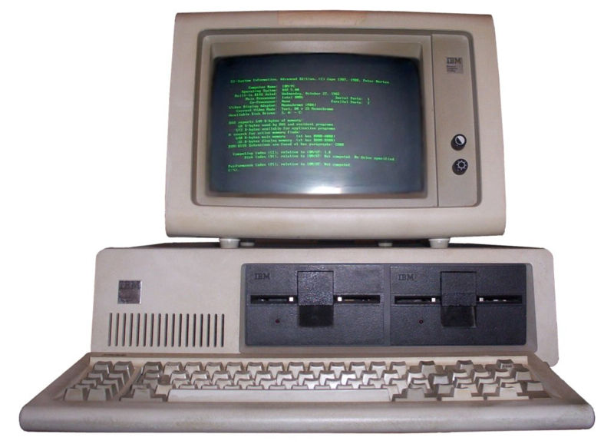
Generation 4: VLSI
Improvements to IC technology made it possible to integrate more and more transistors in a single chip
SSI (Small Scale Integration): 10-100
MSI (Medium Scale Integration): 100-1,000
LSI (Large Scale Integration): 1,000-10,000
VLSI (Very Large Scale Integration): >10,000
Microprocessors

Slide 34
Generation 5?
The term “Generation 5” is used sometimes to refer to all more or less “sci fi” future developments Voice recognition Artificial intelligence Quantum computing Bio computing Nano technology Learning Natural languages

Slide 35
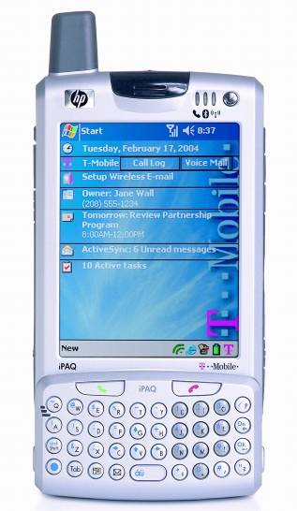

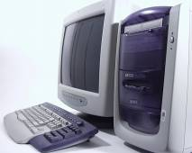

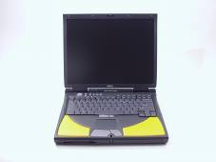


Slide 36
COMPUTER FUNDAMENTALS
Source of Knowledge:
The Mother of Information…
“The Internet”
The World Wide Web

Slide 37
TOPICS
Decimal Number Systems
Binary number Systems
Octal
Hexadecimal
Number conversion

Slide 38
Decimal Number System
The word decimal is a derivative of decem, which is the Latin word for ten.
Numbers today are almost universally written
in a form of notation known as positional
number representation.
A number is represented as a string of digits.

Slide 39
Decimal Number Systems
In a decimal number there are ten such digits
that may be used, ranging in value from zero to
nine
Decimal numbers are positional numbers that have a base or radix of ten.
Why ten ?

Slide 40
Decimal Number Systems
Exactly ten distinct numerals in order to
represent all possible values for each position in
the number, and hence to enable us to represent
all possible integer numbers in decimal notation.
0, 1, 2, 3, 4, 5, 6, 7, 8, and 9 values
For example, a number like "0123456789" has ten positions and each position can contain the digits 0-9.

Slide 41
Decimal Number Systems
Each digit position has a weight associated
with it.
Each digit corresponds to a power of 10 based on its position in the number
Number’s value = a weighted sum of the digits

Slide 42
Decimal Number Systems
Number’s value = a weighted sum of the digits
Number’ value = digit * 10^{x} + digit * 10^{x} where x = (position number - 1).
It sounds complicated ?

Slide 43
Decimal Number Systems
The powers of 10 increment from 0, 1, 2, etc. as you move right to left
Hundreds | Tens | Units

Slide 44
Decimal Number Systems
The BASE is 10 or Dec or simply D
BASE = 10
10 ³
10³=1000
10²=100
10¹=10
10⁰=1
Power or Exponent
Base 10

Slide 45
Decimal Number Systems
Example
1234₁₀ = 1x 10³ + 2x 10² + 3x10¹ +4x10⁰
= 1000 + 200 + 30 + 4
= 1234₁₀

Slide 46
Decimal Number Systems
Example
9876_{D} = 9x 10³ + 8x 10² + 7x10¹ +6x10⁰
= 9000 + 800 + 70 + 6
= 9876_{D}

Slide 47
Decimal Number Systems
Summary
In the decimal system, there are 10 digits (0 through 9) which combine to form numbers as follows:
0 1 2 3 4 5 6 7 8 9 10 11 12 13 14 15 16 17 18 19 20 21 22 ...

Slide 48
Binary Number Systems
The term computer numbering formats refers to the schemes implemented in digital computer and calculator hardware and software to represent numbers
Digital Computers and Calculator use a binary systems
Why binary?

Slide 49
Binary Number Systems
Easy to represent binary values electrically
• Voltages and currents.
• Can be implemented using circuits
• Create the building blocks of modern computers

Slide 50
Binary Number Systems
Reliability
With only 2 values, can be widely separated, therefore clearly differentiated
Binary numbers are made of binary digits

Slide 51
Binary Number Systems
Binary DigiTs (BITs) can be represented
electronically:
… 0 (no signal)
… 1 (signal)

Slide 52
Binary Number Systems
Base is 2 or ‘b’ or ‘B’ or ‘Bin’
Two symbols: 0 and 1
Each place is weighted by the power of 2

Slide 53
Binary Number Systems
All the information in the digital computer is represented as bit patterns
What is a bit pattern?
01010101
This is called as the bit pattern
This is one bit

Slide 54
Binary Number Systems
Look at this bit pattern
0101 0101
How many bits are present ?
Count the number of ones and the zeros in the above pattern
Answer = Total 8 bits

Slide 55
Binary Number Systems
0101 0101
This pattern is represented as follows in the digital computer
Bit7 | Bit 6 | Bit 5 | Bit 4 | Bit 3 | Bit 2 | Bit 1 | Bit 0
0 | 1 | 0 | 1 | 0 | 1 | 0 | 1

Slide 56
Binary Number Systems
A single bit can represent two states:0 1
Therefore, if you take two bits, you can use them to represent four unique states:
00, 01, 10, & 11
And, if you have three bits, then you can use them to represent eight unique states:
000, 001, 010, 011, 100, 101, 110, & 111

Slide 57
Binary Number Systems
With every bit you add, you double the number of states you can represent. Therefore, the expression for the number of states with n bits is 2^{n}. Most computers operate on information in groups of 8 bits,

Slide 58
Binary Number Systems
Bit7 | Bit 6 | Bit 5 | Bit 4 | Bit 3 | Bit 2 | Bit 1 | Bit 0
0 | 1 | 0 | 1 | 0 | 1 | 0 | 1
There are 8 bits in the above table
Group of 4 bits = 1 Nibble
Group of 8 bits = 1 Byte
Group of 16 bits = 1 Word 2 Bytes = 1 Word

Slide 59
Binary Number Systems
Bit7 | Bit 6 | Bit 5 | Bit 4 | Bit 3 | Bit 2 | Bit 1 | Bit 0
0 | 1 | 0 | 1 | 0 | 1 | 0 | 1
There are 8 bits in the above table
Bit 0 is called the Least Significant Bit LSB
Bit 1 is called the Most Significant Bit MSB

Slide 60
Binary Number Systems
Bit positions and their values
Bit7 | Bit 6 | Bit 5 | Bit 4 | Bit 3 | Bit 2 | Bit 1 | Bit 0
2⁷ | 2⁶ | 2⁵ | 2⁴ | 2³ | 2² | 2¹ | 2⁰
128 | 64 | 32 | 16 | 8 | 4 | 2 | 1

Slide 61
Convert Decimal to Binary
For Each Digit Position
Divide decimal number by the base (e.g. 2)
2. The remainder is the lowest-order digit
3. Repeat first two steps until no divisor remains.

Slide 62
Convert Decimal to Binary
Example: Convert Decimal 13 (13 ₁₀) to Binary :
Repeated division by 2 (till quotient is zero)
Divide-by -2 | Quotient | Remainder | Binary Bits
13/2 6 / 2 3 / 2 1 / 2 | 6 3 1 0 | 1 0 1 1 | Bit 0 = 1 Bit 1 = 0 Bit 3 = 1 Bit 4 = 1
Answer = 1101₂

Slide 63
Convert Binary to Decimal
Example: Convert 1101₂
Multiply each 1 bit by the appropriate power of 2 and add them together.
1 0 1 1
Bit 1
Bit 0
Bit 3
Bit 2

Slide 64
Convert Binary to Decimal
Example: Convert 1101₂
Bit7 | Bit 6 | Bit 5 | Bit 4 | Bit 3 | Bit 2 | Bit 1 | Bit 0
2⁷ | 2⁶ | 2⁵ | 2⁴ | 2³ | 2² | 2¹ | 2⁰
128 | 64 | 32 | 16 | 8 | 4 | 2 | 1
 |  |  |  | 1 | 1 | 0 | 1
Multiply with these values
8 x 1 + 4 x 1 + 2 x 0 + 1x 1 = 8 + 4 + 0 + 1
= 13

Slide 65
Binary Number Systems
Example:
1011₂ or 1011 _{B}
= 1 x 2³ + 0 x 2² + 1 x 2¹ + 1 x 2⁰
= 8 + 0 + 2 +1
= 11₁₀

Slide 66
Binary Number Systems
Example:
10110₂ or 10110 _{B}
1 x 2⁴+0 x 2³ + 1 x 2² + 1 x 2¹ + 0 x 2⁰
= 16 + 0 + 4 +2+0
= 22₁₀

Slide 67
Other Number Systems
Octal and hex are a convenient way to represent binary numbers, as used by computers.
Computer mechanics often need to write out binary quantities, but in practice writing out a binary number such as

Slide 68
Other Number Systems
1001001101010001
is tedious, and prone to errors.
Therefore, binary quantities are written in a base-8 ("octal") or, much more commonly, a base-16 ("hexadecimal" or "hex") number format.

Slide 69
Octal Number Systems
Base = 8 or ‘o’ or ‘Oct’
8 symbols: { 0, 1, 2, 3, 4, 5, 6, 7}
Example 123, 567, 7654 etc
987 This is incorrect why?
How to represent a Decimal Number using a Octal Number System ?

Slide 70
Octal Number Systems
Repeated Division by 8
Example
213₁₀ = ( )₈ ?
Divide-by -8 | Quotient | Remainder | Octal digit
213 / 8 26 / 8 3 / 8 | 26 3 0 | 5 2 3 | Lower digit = 5 Second digit =2 Third digit =3
Answer = 325₈

Slide 71
Octal Number Systems
How to convert 325₈ back to Decimal ?
Use this table and multiply the digits with the position values
Digit 8 | Digit 7 | Digit 6 | Digit 5 | Digit 4 | Digit 3 | Digit 2 | Digit 1
8⁷ | 8⁶ | 8⁵ | 8⁴ | 8³ | 8² | 8¹ | 8⁰
…… | …… | 32768 | 4096 | 512 | 64 | 8 | 1

Slide 72
Octal Number Systems
How to convert 325₈ back to Decimal ?
Consider the above number
3 2 5 ₍₈₎
3 x 8² + 2 x 8¹ + 5 x 8⁰ = 3 x 64 + 2 x 8 + 5 x 1
= 192 +16 + 5
= 213
Digit 1
Digit 3
Digit 2

Slide 73
Octal Number Systems
Example Convert 611₈
Consider the above number
6 1 1 ₍₈₎
6 x 8² + 1 x 8¹ + 1 x 8⁰ = 6 x 64 + 1 x 8 + 1 x 1
= 384 + 8 + 1
= 393
Digit 1
Digit 3
Digit 2

Slide 74
Octal Number Systems
Convert 393 to octal
Divide-by -8 | Quotient | Remainder | Octal digit
393 / 8 49 / 8 6 / 8 | 49 6 0 | 1 1 6 | Lower digit = 1 Second digit =1 Third digit =6
Answer = 611₈

Slide 75
Hexadecimal Number Systems
Base = 16 or ‘H’ or ‘Hex’
16 symbols: { 0, 1, 2, 3, 4, 5, 6, 7,8,9 }
{ 10=A, 11=B, 12=C, 13=D, 14=E, 15= F}

Slide 76
Hexadecimal Number Systems
{0,1,2,3,4,5,6,7,8,9,A,B,C,D,E,F} It uses 6 Letters !
Example AB12, 876F, FFFF etc
How to represent a Decimal Number using a Hexadecimal Number System ?

Slide 77
Hex Number Systems
Repeated Division by 16
Example
213₁₀ = ( )₁₆ ?
Divide-by -16 | Quotient | Remainder | Hex digit
213 / 16 13 / 16 | 13 0 | 5 13 | Lower digit = 5 Second digit =D
Answer = D5₁₆

Slide 78
Hex Number Systems
How to convert D5₁₆ back to Decimal ?
Use this table and multiply the digits with the position values
Digit 8 | Digit 7 | Digit 6 | Digit 5 | Digit 4 | Digit 3 | Digit 2 | Digit 1
16⁷ | 16⁶ | 16⁵ | 16⁴ | 16³ | 16² | 16¹ | 16⁰
…… | …… | ….. | …… | 4096 | 256 | 16 | 1

Slide 79
Hex Number Systems
How to convert D5₁₆ back to Decimal ?
Consider the above number
D 5 ₍₁₆₎
D x 16¹ + 5 x 16⁰ = 13 x 16 + 5 x 1
= 208 + 5
= 213
Digit 1
Digit 2

Slide 80
TOPICS
Octal
Hexadecimal
Number conversion

Slide 81
Other Number Systems
Octal and hex are a convenient way to represent binary numbers, as used by computers.
Computer mechanics often need to write out binary quantities, but in practice writing out a binary number such as

Slide 82
Other Number Systems
1001001101010001
is tedious, and prone to errors.
Therefore, binary quantities are written in a base-8 ("octal") or, much more commonly, a base-16 ("hexadecimal" or "hex") number format.

Slide 83
Octal Number Systems
Base = 8 or ‘o’ or ‘Oct’
8 symbols: { 0, 1, 2, 3, 4, 5, 6, 7}
Example 123, 567, 7654 etc
987 This is incorrect why?
How to represent a Decimal Number using a Octal Number System ?

Slide 84
Octal Number Systems
Repeated Division by 8
Example
213₁₀ = ( )₈ ?
Divide-by -8 | Quotient | Remainder | Octal digit
213 / 8 26 / 8 3 / 8 | 26 3 0 | 5 2 3 | Lower digit = 5 Second digit =2 Third digit =3
Answer = 325₈

Slide 85
Octal Number Systems
How to convert 325₈ back to Decimal ?
Use this table and multiply the digits with the position values
Digit 8 | Digit 7 | Digit 6 | Digit 5 | Digit 4 | Digit 3 | Digit 2 | Digit 1
8⁷ | 8⁶ | 8⁵ | 8⁴ | 8³ | 8² | 8¹ | 8⁰
…… | …… | 32768 | 4096 | 512 | 64 | 8 | 1

Slide 86
Octal Number Systems
How to convert 325₈ back to Decimal ?
Consider the above number
3 2 5 ₍₈₎
3 x 8² + 2 x 8¹ + 5 x 8⁰ = 3 x 64 + 2 x 8 + 5 x 1
= 192 +16 + 5
= 213
Digit 1
Digit 3
Digit 2

Slide 87
Octal Number Systems
Example Convert 611₈
Consider the above number
6 1 1 ₍₈₎
6 x 8² + 1 x 8¹ + 1 x 8⁰ = 6 x 64 + 1 x 8 + 1 x 1
= 384 + 8 + 1
= 393
Digit 1
Digit 3
Digit 2

Slide 88
Octal Number Systems
Convert 393 to octal
Divide-by -8 | Quotient | Remainder | Octal digit
393 / 8 49 / 8 6 / 8 | 49 6 0 | 1 1 6 | Lower digit = 1 Second digit =1 Third digit =6
Answer = 611₈

Slide 89
Hexadecimal Number Systems
Base = 16 or ‘H’ or ‘Hex’
16 symbols: { 0, 1, 2, 3, 4, 5, 6, 7,8,9 }
{ 10=A, 11=B, 12=C, 13=D, 14=E, 15= F}

Slide 90
Hexadecimal Number Systems
{0,1,2,3,4,5,6,7,8,9,A,B,C,D,E,F} It uses 6 Letters !
Example AB12, 876F, FFFF etc
How to represent a Decimal Number using a Hexadecimal Number System ?

Slide 91
Hex Number Systems
Repeated Division by 16
Example
213₁₀ = ( )₁₆ ?
Divide-by -16 | Quotient | Remainder | Hex digit
213 / 16 13 / 16 | 13 0 | 5 13 | Lower digit = 5 Second digit =D
Answer = D5₁₆

Slide 92
Hex Number Systems
How to convert D5₁₆ back to Decimal ?
Use this table and multiply the digits with the position values
Digit 8 | Digit 7 | Digit 6 | Digit 5 | Digit 4 | Digit 3 | Digit 2 | Digit 1
16⁷ | 16⁶ | 16⁵ | 16⁴ | 16³ | 16² | 16¹ | 16⁰
…… | …… | ….. | …… | 4096 | 256 | 16 | 1

Slide 93
Hex Number Systems
How to convert D5₁₆ back to Decimal ?
Consider the above number
D 5 ₍₁₆₎
D x 16¹ + 5 x 16⁰ = 13 x 16 + 5 x 1
= 208 + 5
= 213
Digit 1
Digit 2

Slide 94
Binary Number Systems
A single bit can represent two states:0 1
Therefore, if you take two bits, you can use them to represent four unique states:
00, 01, 10, & 11
And, if you have three bits, then you can use them to represent eight unique states:
000, 001, 010, 011, 100, 101, 110, & 111

Slide 95
Binary Number Systems
And, if you have three bits, then you can use them to represent eight unique states:
These have a perfect correspondence to Octal
000 = Octal 0 100 = Octal 4
001 = Octal 1 101 = Octal 5
010 = Octal 2 110 = Octal 6
011 = Octal 3 111 = Octal 7

Slide 96
Binary Number Systems
With every bit you add, you double the number of states you can represent. Therefore, the expression for the number of states with n bits is 2^{n}. Most computers operate on information in groups of 8 bits,

Slide 97
Binary Number Systems
A unit of four bits, or half an octet, is often called
a nibble (or nybble). It can encode 16 different
values, such as the numbers 0 to 15. Any arbitrary
sequence of bits could be used in principle,

Slide 98
Binary Number Systems
, but in practice the most common scheme is:
0000 = decimal 00 hex 0 1000 = decimal 08 hex 8
0001 = decimal 01 hex 1 1001 = decimal 09 hex 9
0010 = decimal 02 hex 2 1010 = decimal 10 hex A
0011 = decimal 03 hex 3 1011 = decimal 11 hex B
0100 = decimal 04 hex 4 1100 = decimal 12 hex C
0101 = decimal 05 hex 5 1101 = decimal 13 hex D
0110 = decimal 06 hex 6 1110 = decimal 14 hex E
0111 = decimal 07 hex 7 1111 = decimal 15 hex F
These have perfect correspondence to Hex

Slide 99
Convert Binary to Hex
Group into 4's starting at least significant symbol (if the number of bits is not evenly divisible by 4, then add 0's at the most significant end)
write 1 hex digit for each group

Slide 100
Convert Binary to Hex
Example: Convert 1001 1110 0111 0000 to Hex
After grouping follow the procedure as discussed in the previous section use the symbols of Hex number system like 13=E
1001 1110 0111 0000
9 E 7 0

Slide 101
Convert Binary to Hex
Example: Convert 100 1010 011 0000 to Hex
10 0101 0011 0000
0010 0101 0011 0000
2 5 3 0
This group has only two bits, to make it a group of 4 bits add zeros in MSB position

Slide 102
Convert Hex to Binary
For each of the Hex digit write its binary equivalent (use 4 bits to represent)
Example
Convert 25A0 to binary
0010 0101 1010 0000

Slide 103
Convert Binary to Octal
Group into 3's starting at least significant symbol (if the number of bits is not evenly divisible by 3, then add 0's at the most significant end)
write 1 octal digit for each group

Slide 104
Convert Binary to Octal
Example: Convert 1001 1110 0111 0000 to Oct
After grouping follow the procedure as discussed in the previous section use the symbols of Oct number system like
add two zeros here
001 001 111 001 110 000
1 1 7 1 6 0
Answer = 117160₈

Slide 105
Convert Octal to Binary
For each of the Octal digit write its binary equivalent
Example
Convert 2570 to binary
010 101 111 000

Slide 106
TOPICS
Information Representation
Characters and Images

Slide 107
Information Representation
All information must be rendered into binary in order to be stored on a computer.
Besides numbers, almost all applications must store characters and string information.
Images are pervasive in today’s internet world and must be rendered in binary to be handled by internet browsers.

Slide 108
Character Representation
ASCII – PC workstations
EBCDIC – IBM Mainframes
Unicode – International Character sets

Slide 109
ASCII
ASCII
Expanded name American Standard Code for Information Interchange
Area covered 7-bit coded character set for information interchange
Characteristics/description Specifies coding of space and a set of 94 characters (letters, digits and punctuation or mathematical symbols) suitable for the interchange of basic English language documents. Forms the basis for most computer code sets

Slide 110
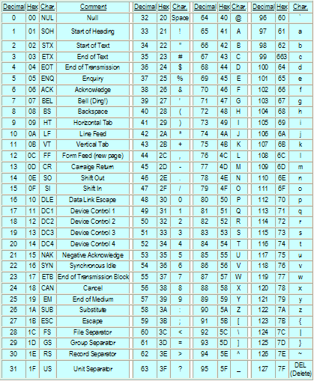
ASCII

Slide 111
EBCDIC
EBCDIC 425( 4 2 5)
Expanded name (0100 0010 0101) Extended Binary Coded Decimal Interchange Code
Proprietary specification developed by IBM
Characteristics/description A set of national character sets for interchange of documents between IBM mainframes. Most EBCDIC character sets do not contain all of the characters defined in the ASCII code

Slide 112
EBCDIC
EBCDIC
Usage Not much used outside of IBM and similar mainframe environments. When transmitting EBCDIC files between systems care needs to be taken to ensure that the systems are set up for the relevant national code set.

Slide 113
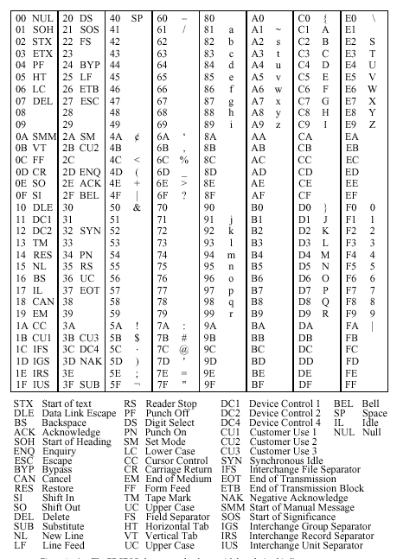
EBCDIC

Slide 114
UNICODE
From MSDN: Unicode can represent all of the world's characters in modern computer use, including technical symbols and special characters used in publishing. Because each Unicode code value is 16 bits wide, it is possible to have separate values for up to 65,536 characters. Unicode-enabled functions are often referred to as "wide-character" functions.

Slide 115
UNICODE
Note that the implementation of Unicode in 16-bit values is referred to as UTF-16. For compatibility with 8- and 7-bit environments, UTF-8 and UTF-7 are two transformations of 16-bit Unicode values. For more information, see The Unicode Standard, Version 2.0.

Slide 116
Questions ?

Slide 117
Data, Representation & Numeracy
In order to understand how data is processed by computers it is necessary to understand
what is data
how is data represented in computers
how is data manipulated and processed

Slide 118
Bits, Bytes, Words ...
The basic units of data are organized as follows
bit
this is the fundamental unit of data
2-state switch values: 0/1 (e.g. true/false; off/on)
byte
a group of 8 bits taken as a single unit
the smallest unit of memory that is addressable
word
the size of the (data) bus, all bits simultaneously transferred
Pentium I, II, III 32 bits (4 bytes)
Pentium IV 64 bits (8 bytes)
other units are used, such as blocks, strings, and so on
these are considered non-standard application structures

Slide 119
Size terminology
The following prefix terms are used to denote timing interval size (seconds):
10⁻³ milli
10⁻⁶ micro
10⁻⁹ nano
10⁻¹² pico
10⁻¹⁵ femto
The following prefix terms are used to denote storage device size (bytes):
2¹⁰ kilo (1024)
2²⁰ mega ( ~ 10⁶ )
2³⁰ giga ( ~ 10⁹ )
2⁴⁰ tera ( ~ 10¹² )
2⁵⁰ peta ( ~ 10¹⁵ )

Slide 120
Binary Coding
Binary, or base-2, coding is used for all data in the computer
2-state switches
only 0 and 1 are used as values
each corresponds to a specific electrical (magnetic/optical) signal value
Characters
the ASCII system is used to represent printable characters and also some non-printable signals used in inter-computer communication across networks
Numbers
unsigned integer
signed integer
real, or floating point, numbers
decimal (base-10) numbers are also used in computers

Slide 121
Positional Representation (1)
In the decimal system (base-10) we may represent a general, positive number N in the form: N = d_{L-1} d_{L-2} … d₂ d₁ d₀ . f₁ f₂ … f_{M} where each d or f represents a single decimal digit, 0 to 9.
This can be rewritten in the form: L-1 M N = Sum d_{k} * 10^{k} + Sum f_{k} * 10^{-k} k=0 k=1
This representation permits us to perform the basic arithmetic operations using conventional techniques taught at an early age.

Slide 122
Positional Representation (2)
In a system based on a different multiplier, or radix (we say, “base-R”) we may represent a general, positive number N in the form: N = d_{L-1} d_{L-2} … d₂ d₁ d₀ . f₁ f₂ … f_{M} where each d or f represents a single digit, but now the concept and representation of digit takes on a new meaning.
This can be rewritten in the form: L-1 M N = Sum d_{k} * R^{k} + Sum f_{k} * R^{-k} ; 0 ≤ d_{k} , f_{k} < R k=0 k=1
This representation still permits us to perform the basic arithmetic operations as we did for decimal arithmetic!

Slide 123
Unsigned Binary
Binary Dec. Binary Dec.
0111 7 1111 15
0110 6 1110 14
0101 5 1101 13
0100 4 1100 12
0011 3 1011 11
0010 2 1010 10
0001 1 1001 9
0000 0 1000 8
Non-negative integers (greater or equal to zero)
Range from 0 (smallest) to 2^{L}-1 (largest) for an L-bit representation
We can construct an unsigned binary sequence using the algorithm
Build up starting from 0.
Add 1 to the previous number.
Repeat previous step until a string of 1’s of length L is reached.

Slide 124
Signed Binary - 1’s complement
In most cases we require both positive and negative integers
One idea for “designing” negative numbers uses complementation
change 0’s to 1’s and 1’s to 0’s 0101 1010

Slide 125
Signed Binary - 1’s complement
In most cases we require both positive and negative integers
One idea for “designing” negative numbers uses complementation
change 0’s to 1’s and 1’s to 0’s
Values range from -2^{L-1} +1 (most negative) to 2^{L-1}-1 (largest, most positive) for an L-bit representation.
Permits two different representations of zero!
Binary Dec. Binary Dec.
0111 7 1000 -7
0110 6 1001 -6
0101 5 1010 -5
0100 4 1011 -4
0011 3 1100 -3
0010 2 1101 -2
0001 1 1110 -1
0000 0 1111 -0

Slide 126
1110
1’s comp = 0001
1
-----------------------
0010

Slide 127
Signed Binary - 2’s complement
We need a more efficient representation of positive and negative integers using an L-bit form.
One straightforward approach is to consider the operation: X + Y 0 What representation of Y gives a zero sum?
00000011
+ bbbbbbb
00000000
3
Y

Slide 128
Signed Binary - 2’s complement
We need a more efficient representation of positive and negative integers using an L-bit form.
One straightforward approach is to consider the operation: X + Y 0 What representation of Y gives a zero sum?
1111111
00000011
+ 11111101
1 00000000
Carry
3
-3
Carry out

Slide 129
Signed Binary - 2’s complement
We need a more efficient representation of positive and negative integers using an L-bit form.
The 2’s complement scheme is based on the algorithm:
1. Find the 1’s complement
2. Add 1 to the result to find the 2’s complement form.
3 00000011
~3 11111100
+ 1
-3 11111101
1
2

Slide 130
(r-1)’s and r’s complements
In an arbitrary radix of fixed (finite) representation length L, there are two related complements that are important.
(r-1)’s complement form.
Given the number N in radix-r form, the (r-1)’s complement is defined as r ^{L} – 1 – N
Consider r = 10, L = 4 and N = 2468. Clearly, r ⁴ = 10000, thus r ⁴ – 1 = 9999. Thus, 9999 - 2468 7531 Easy!
Note that the sum of N and the (r-1)’s complement of N is always a string of (r-1)’s (9 in this example).
r’s complement form
The r’s complement is found from the (r-1)’s complement by just adding 1.
Note that this guarantees that the sum of N and its r’s complement is just zero (0) to within the size L of the representation!

Slide 131
Subtraction of unsigned Numbers
Problem: Find (M – N) where both M and N are unsigned numbers in base-r, size L digits.
Recall that we first learned to do this subtraction using the concept of “borrowing” – computers can be designed to do this, but there is a simpler way using r’s complements and addition
Example: M > N, L=5 ( M = 72532, N = 13250) Borrowing: 72532 10’s Compl.: 72532 - 13250 + 86750 59282 159282 Discard Carry Final Answer: 59282

Slide 132
Subtraction of unsigned Numbers
Example: M < N, L=5 ( M = 13250, N = 72532) Borrowing: 13250 10’s Compl.: 13250 - 72532 + 27467 ????? 40717 Find 10’s compl., add minus Final Answer: -59282

Slide 133
Converting between arbitrary bases
Consider the problem of converting the number 153₁₀ into its equivalent number in base-13.
Although this may seem strange at first, it is solved by repeatedly dividing 153 (and successive quotients) by 13 and collecting remainders, hence:
13 into 153 11 10 (A) 0 11 (B) ANSWER: BA
Problem: What is the radix of the integer numbers (coefficients) below if the solution to the quadratic equation shown is x=5? x² – 12 x + 39 = 0

Slide 134
Substituting x = 5 and expanding the positional representations of each coefficient:
5² – ( 1*R + 2 ) * 5 + ( 3*R + 9 )
= 25 – 5*R – 10 + 3*R + 9
= 24 – 2*R = 0
It follows from the last step that R = 12.
WARNING: Converting to arbitary bases may be quite difficult. If terms up to R⁴ arise (a quartic equation) it can be solved exactly, but not for higher powers. Such problems require brute force.

Slide 135
Floating Point
Representations of real numbers, both positive and negative. The range required is often quite large.
Use scientific notation
Examples: 123.456 0.123456 x 10³ - 0.000123456 - 0.123456 x 10⁻³ sign fraction exponent 0 + (pos.) (pos. or neg.) 1 -

Slide 136
Floating Point
Note that the exponent may be positive or negative. We use the 2’s complement form. The exponent is then called the characteristic.
When the leftmost (ie. most significant) fraction bit is one (1) the fraction is called normalized; otherwise it is unnormalized.
Use scientific notation to represent the
sign
fraction (mantissa)
exponent sign exponent fraction 0 + (2’s compl.) 1 -

Slide 137
Binary Coded Decimal (BCD)
Many computers contain logic to process decimal representations directly.
The standard representation is based on an ASCII-compatible scheme for each separate decimal digit. This is called the BCD scheme.
Note that a minimum of 4 bits is required to represent all 10 decimal digits.
0 0000 5 0101
1 0001 6 0110
2 0010 7 0111
3 0011 8 1000
4 0100 9 1001

Slide 138
Binary Conversions - Octal, Hexadecimal
It is important to understand how to convert values from one to another representation.
Some conversions are straightforward, while others require more effort.
Example: Binary to Octal (base-8) Octal Digits: 0 1 2 3 4 5 6 7 Binary: 1 0 1 1 0 0 0 1 1 0 1

Slide 139
Binary Conversions - Octal, Hexadecimal
It is important to understand how to convert values from one to another representation.
Some conversions are straightforward, while others require more effort.
Example: Binary to Octal (base-8) Octal Digits: 0 1 2 3 4 5 6 7 Binary: 1 0 1 1 0 0 0 1 1 0 1 (Groups of 3 digits, right to left)
For fractions, group bits left to right from the radix point

Slide 140
Binary Conversions - Octal, Hexadecimal
It is important to understand how to convert values from one to another representation.
Some conversions are straightforward, while others require more effort.
Example: Binary to Octal (base-8) Octal Digits: 0 1 2 3 4 5 6 7 Binary: 1 0 1 1 0 0 0 1 1 0 1 Convert each group to an octal digit. Octal: 2 6 1 5

Slide 141
Binary Conversions - Octal, Hexadecimal
It is important to understand how to convert values from one to another representation.
Some conversions are straightforward, while others require more effort.
Example: Binary to Hexadecimal (base-16) Hexadecimal Digits: 0 1 2 3 4 5 6 7 8 9 A B C D E F Binary: 1 0 1 1 0 0 0 1 1 0 1 0 1 1 Hexadecimal: 2 C 6 B Convert each group of 4 bits to a hexadecimal digit.

Slide 142
Binary/Decimal Conversions
Converting to and from binary to decimal requires some more effort.
Examples: Decimal integer to Binary
Repeatedly divide quotient by 2 until zero is reached.
Record the remainder for each division:
114
57 0
28 1
14 0
7 0
3 1
1 1
0 1
1 1 1 0 0 1 0
Remainders
Quotients

Slide 143
Binary/Decimal Conversions
Converting binary to/from decimal requires some more effort.
Examples: Binary integer to Decimal
Use the positional representation of the binary string, multiplying each successive power of 2 by the value of the binary digit: 1 0 1 1 => 1 x 2³ + 0 x 2² + 1 x 2¹ + 1 x 2⁰

Slide 144
Binary/Decimal Conversions
Converting to and from binary to decimal requires some more effort.
Examples: Decimal fraction (0.12) to Binary
If a repeating sequence develops, then stop after preset number of digits

Slide 145
Repeatedly multiply by 2, each time “stripping”
the integer digit (0 or 1) and leaving the remaining
fractional product residue.
0.12 x 2 0.24 0 (most significant)
0.24 x 2 0.48 0
0.48 x 2 0.96 0
0.96 x 2 1.92 1
0.92 x 2 1.84 1
0.84 x 2 1.68 1
0.68 x 2 1.36 1
0.36 x 2 0.72 0
0.72 x 2 1.44 1 …..
Collect bits: . 0 0 0 1 1 1 1 0 1 . . .

Slide 146
Arithmetic Operations
All of the basic arithmetic operators are typically represented in modern computer ALU’s
These are developed just as in base-10 by virtue of the positional representation properties
Examples:
Addition
Subtraction
Multiplication
Division

Slide 147
Circuit Design for Computers
The relevance of the preceding discussion is directed towards the design of digital circuits for computers
Internal circuits are used for
memory storage units
CPU storage units
ALU operations
CU operations
We will now proceed to lay the foundation for digital circuit design and analysis by studying the Boolean Algebra and the Boolean Calculus.

Slide 148
Summary
We have considered the nature and representation of data
bits, bytes, words
binary codings
numbers
positional representation
unsigned binary
signed binary (2’s complement)
floating point
decimal
conversion from one to another representation
arithmetic operations

Slide 149
Basic Digital Logic Gates
Binary system -- 0 & 1, LOW & HIGH, negated and asserted.
Basic building blocks -- AND, OR, NOT

Slide 150
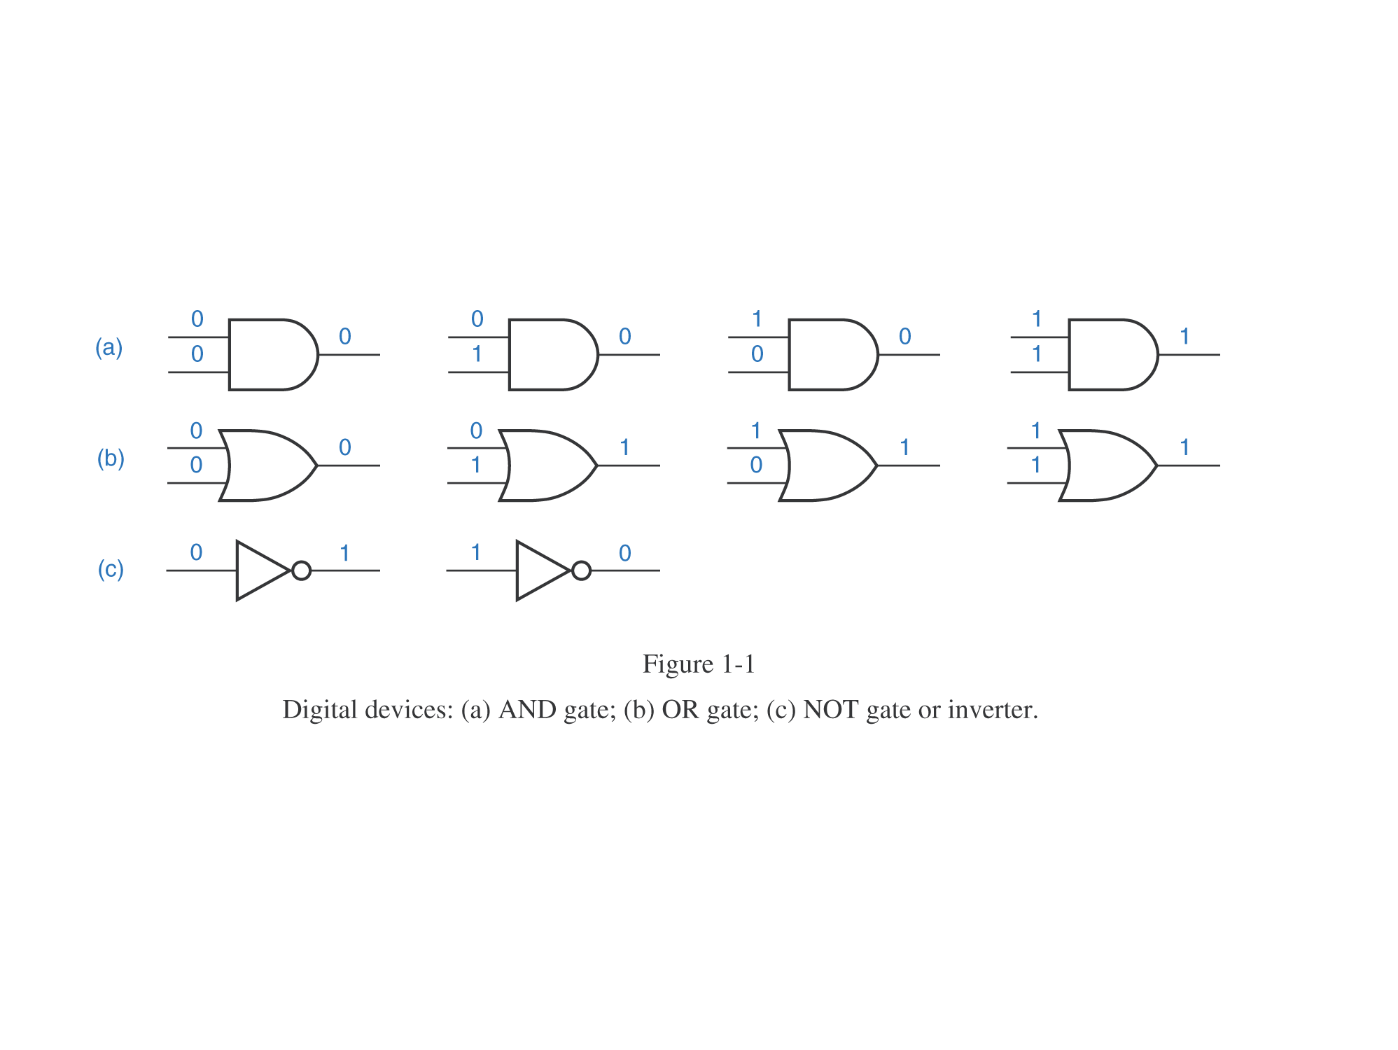
Propagation of binary signals through logic gates

Slide 151
NAND and NOR gates
SOP or Sum-of-Products circuits

Slide 152
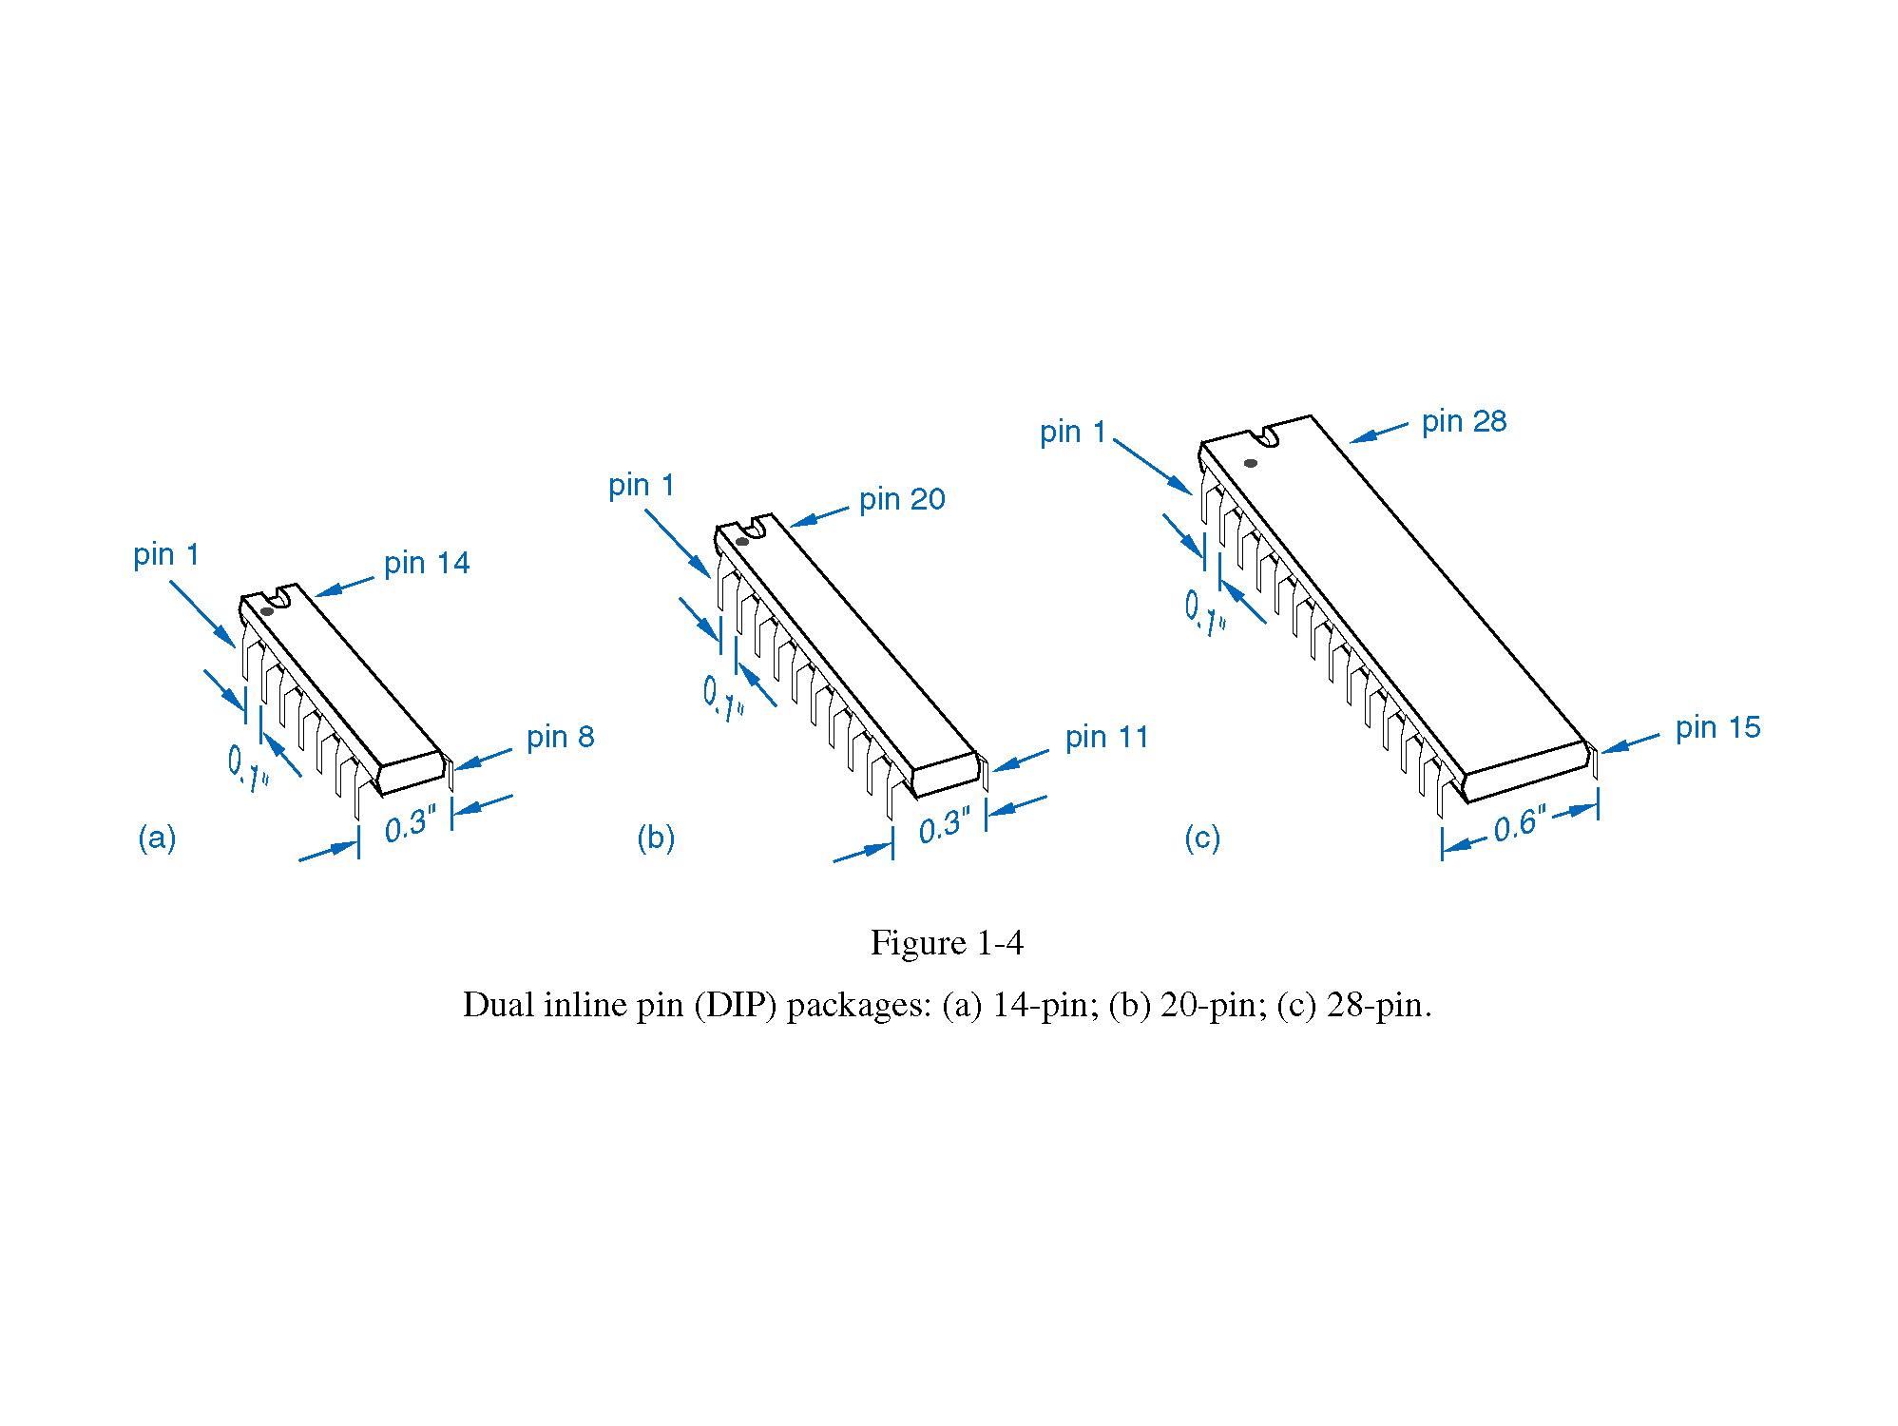
Packaging of digital circuits

Slide 153
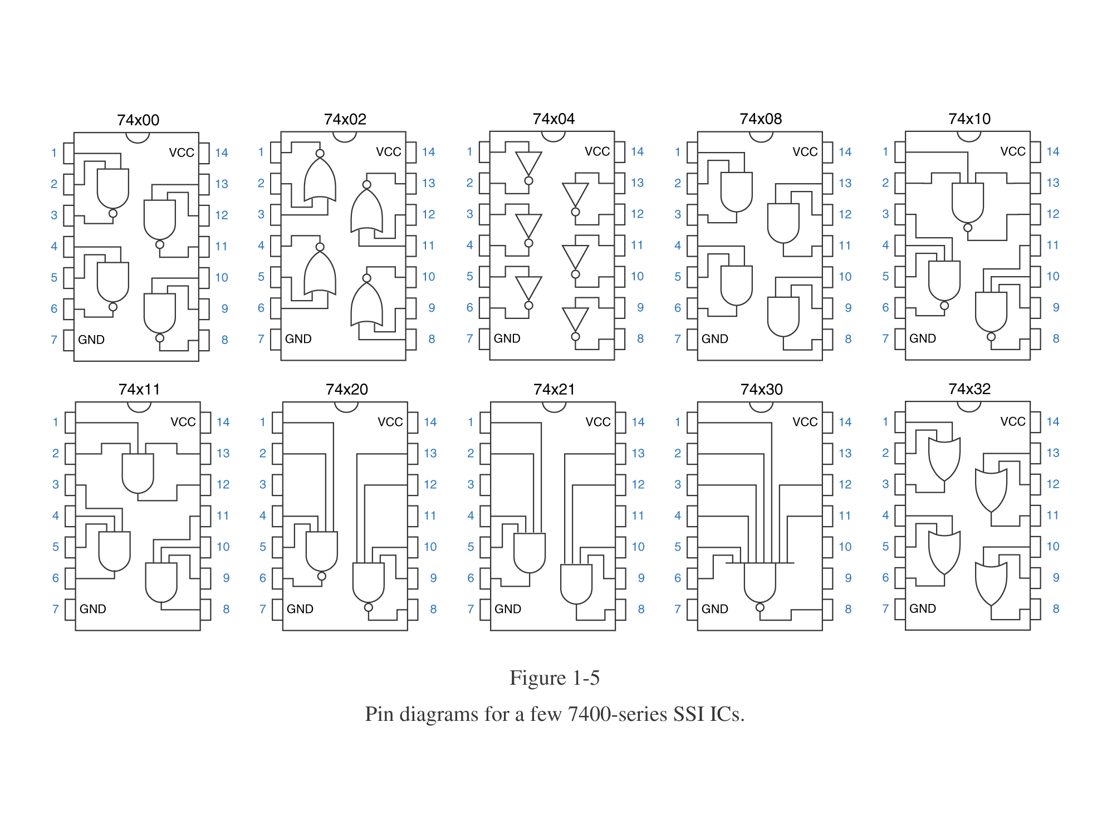
Pin diagrams of TTL digital circuits

Slide 154
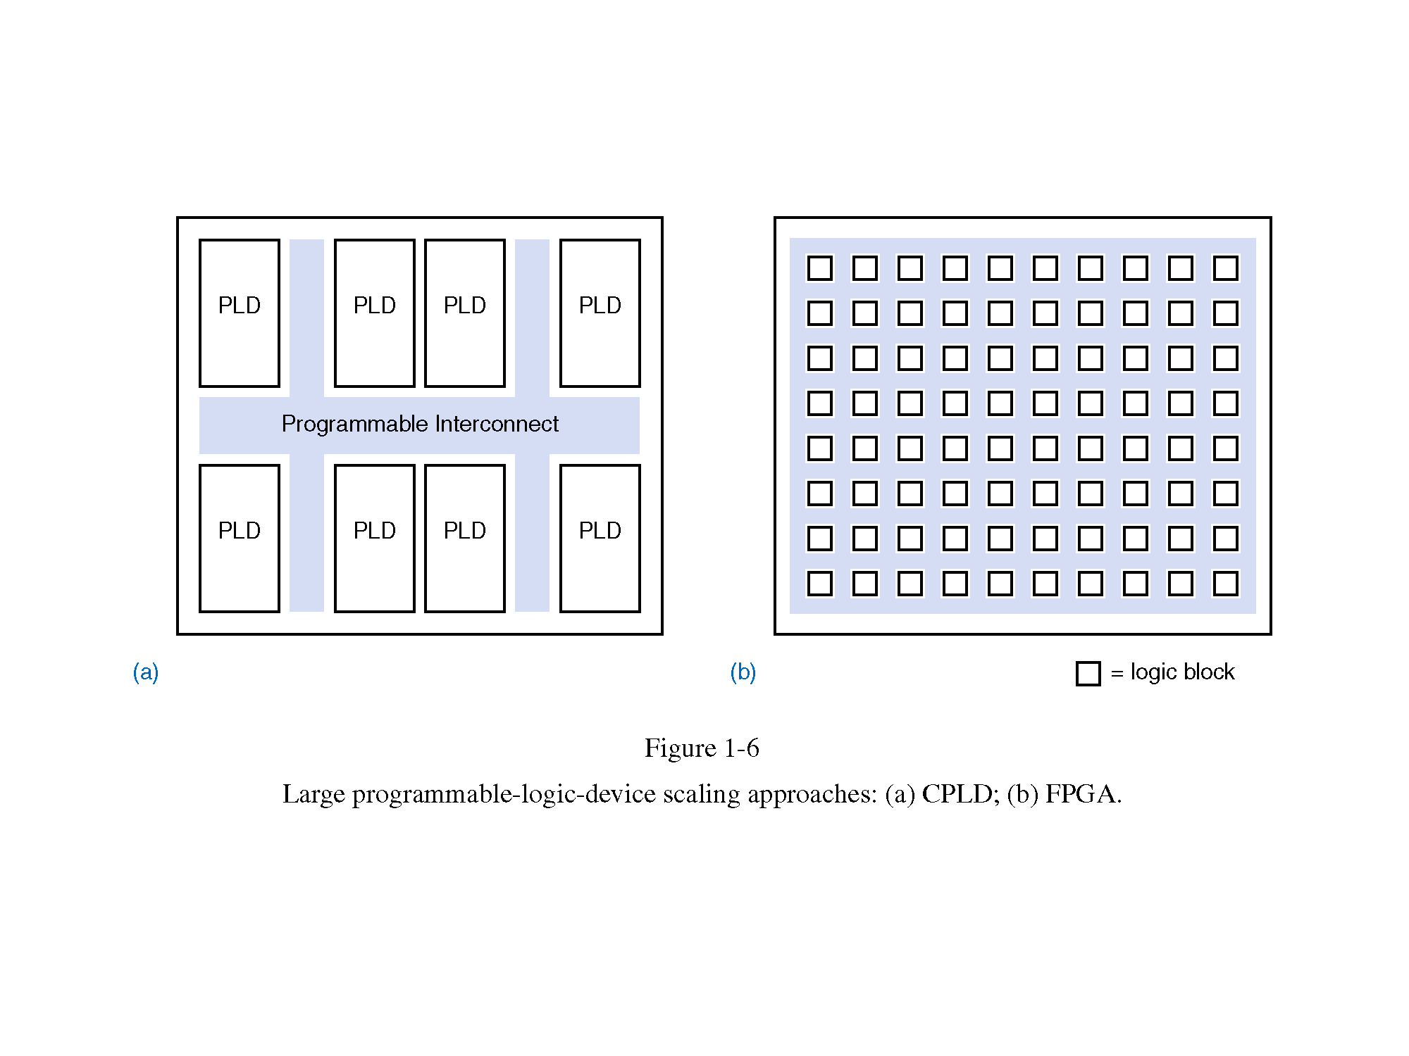
PLDs, CPLDs and FPGAs in brief

Slide 155
Microprocessor System Architecture
RAM
ROM
Micro
processor
Address
Data
Control
Lines
Input
Output

Slide 156
Address, Data, Control Buses:
Bus width often determines CPU strength
How strong am I?
Only as my weakest muscle..

Slide 157
MPU
Internal Registers:
Data Address Register, Program Counter,
Data Register, Accumulator, Instruction Reg.
Arithmetic-Logic Unit
Timing & Control Unit
Address, Data, Control Buses
Instruction Decoder

Slide 158
6502 Microprocessor
Internal Registers:
Data Address Register, Program Counter,
Data Register, Accumulator, Instruction Reg.
Arithmetic-Logic Unit
Timing & Control Unit
Address, Data, Control Buses
Instruction Decoder
MPU
Address bus [16]
DAR
PC
Data bus [8]
DR
ALU
A
IR
Control
bus [8]
ID
T&C

Slide 159
CONTENTS
Introduction
RAM,ROM,PROM,EPROM
Auxiliary Storage Devices-Magnetic Tape, Hard Disk, Floppy Disk
Optical Disks: CD-R Drive,CD-RW disks,DVD,Blue ray Discs.

Slide 160
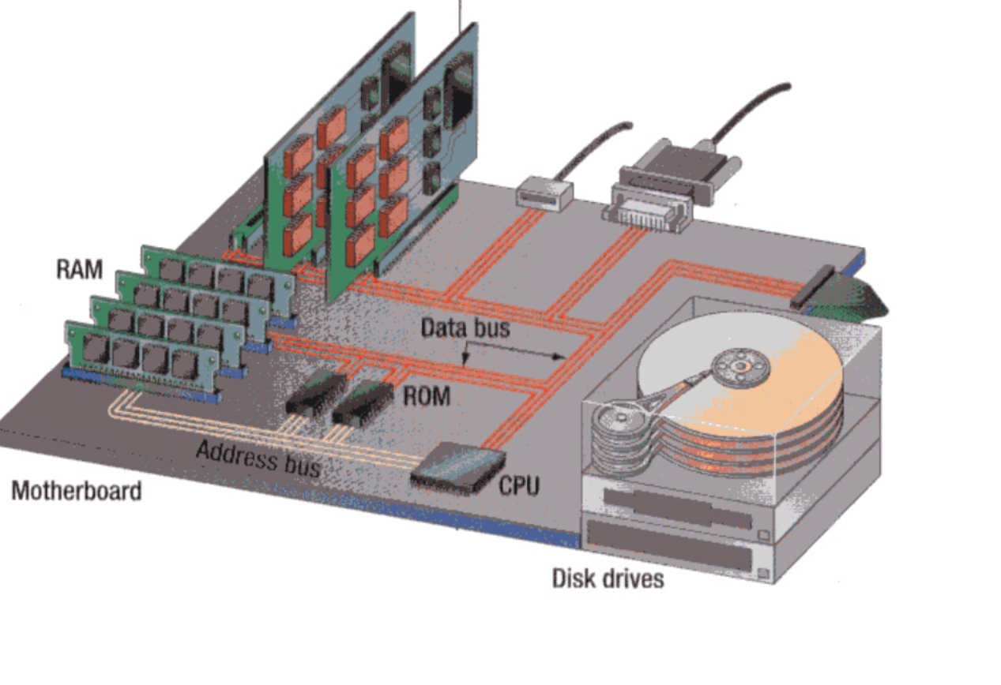

Slide 161
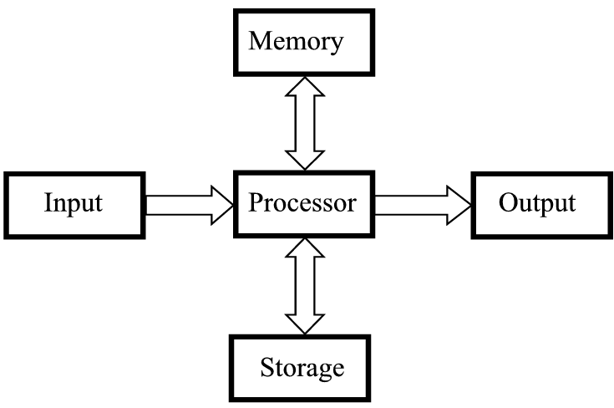
Memory

Slide 162
1. Introduction
Memory Devices (RAM,ROM,PROM,EPROM)
Storage Devices (Auxiliary Storage Devices-Magnetic Tape, Hard Disk, Floppy Disk .Optical Disks: CD-R Drive,CD-RW disks,DVD,Blue ray Discs)

Slide 163
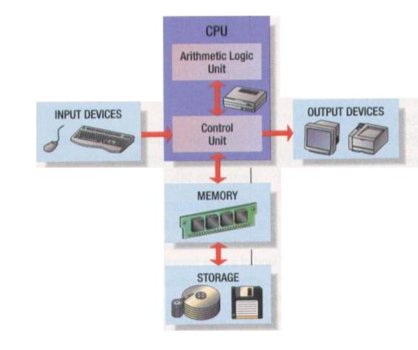

Slide 164
Characteristics of Storage Devices
Speed
Volatility
Access method
Portability
Cost and capacity

Slide 165

Basic Units Of Measurement
off
Bit
Binary digit
Smallest unit of measurement
Two possible values 0 1
on
OR
Byte
8 bits

Slide 166
Small Units Of Measurement (Processor And Memory Speed)
Millisecond (ms) – a thousandth of a second (1/1,000 = 10⁻³)
Microsecond (μs) - a millionth of a second (1/1,000,000 = 10⁻⁶)
Nanosecond (ns) – a billionth of a second (1/1,000,000,000 = 10⁻⁹)

Slide 167
Large Units Of Measurement (Memory, Storage)
Note: powers of two are used because computer memory and storage are based on the basic unit (bit).
Kilobyte (KB) – a thousand bytes (1,024 = 2¹⁰)
Megabyte (MB) - a million (1,048,576 = 2²⁰)

Slide 168
Large Units Of Measurement (Memory, Storage)
Gigabyte (GB) – a billion (1,073,741,824 = 2³⁰)
~ A complete set of encyclopedias requires about 700 MB of storage
~ 30 minutes of video (1/4 of the information stored on a typical DVD)

Slide 169
Large Units Of Measurement (Memory, Storage)
Terabyte (TB) – a trillion (1,099,511,627,776 = 2⁴⁰)
~ 20 million four-drawer filing cabinets full of text
~ 200 DVD’s of information

Slide 170
CONTENTS
Introduction
RAM,ROM,PROM,EPROM
Auxiliary Storage Devices-Magnetic Tape, Hard Disk, Floppy Disk
Optical Disks: CD-R Drive,CD-RW disks,DVD,Blue ray Discs.

Slide 171
2. RAM,ROM,PROM,EPROM
Memory Devices
Memory: Is one or more sets of chips that store data/program instructions, either temporarily or permanently .
It is critical processing component in any computer
PCs use several different types

Slide 172
RAM,ROM,PROM,EPROM
Memory Devices
Two most important are
RAM(Random Access Memory)
ROM(Read-only Memory)
They work in different ways and perform distinct functions
CPU Registers
Cache Memory

Slide 173
RAM
RAM is packaged as a chip.
Basic storage unit is a cell (one bit per cell).
Multiple RAM chips form a memory.
Random Access Memory
Volatile
Used for temporary storage
Typical ranges 256 MB - 4 GB
Random Access means direct access to any part of memory

Slide 174
Nonvolatile Memories(ROM)
DRAM and SRAM are volatile memories
Lose information if powered off.
Nonvolatile memories retain value even if powered off.
Generic name is read-only memory (ROM).
Misleading because some ROMs can be read and modified.

Slide 175
Nonvolatile Memories(ROM)
Types of ROMs
Programmable ROM (PROM)
Eraseable programmable ROM (EPROM)
Electrically eraseable PROM (EEPROM)
Flash memory (used in portable digital devices)
Firmware (Program instruction used frequently)
Program stored in a ROM
Boot time code, BIOS (basic input/output system)
graphics cards, disk controllers.

Slide 176
Memory

Slide 177
3. Storage Vs. Memory
Memory (e.g., RAM)
Keep the information for a shorter period of time (usually volatile)
Faster
More expensive

Slide 178
3. Storage Vs. Memory
Storage (e.g., Hard disk)
The information is retained longer (non-volatile)
Slower
Cheaper

Slide 179
CONTENTS
Introduction
RAM,ROM,PROM,EPROM
Auxiliary Storage Devices-Magnetic Tape, Hard Disk, Floppy Disk
Optical Disks: CD-R Drive,CD-RW disks,DVD,Blue ray Discs.

Slide 180
Categories Of Storage
Magnetic
Floppy disks
Zip disks
Hard drives
Optical
CD-ROM
DVD
Solid state storage devices
USB Key (a very common form of solid state storage)

Slide 181
Magnetic Storage
Exploits duality of magnetism and electricity
Converts electrical signals into magnetic charges
Captures magnetic charge on a storage medium
Later regenerates electrical current from stored magnetic charge
Polarity of magnetic charge represents bit values zero and one

Slide 182
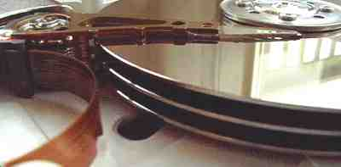
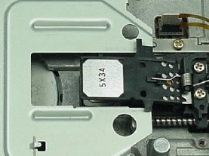
Magnetic Drives

Slide 183
Magnetic Disk
Flat, circular platter with metallic coating that is rotated beneath read/write heads
Random access device; read/write head can be moved to any location on the platter
Hard disks and floppy disks
Cost performance leader for general-purpose on-line secondary storage

Slide 184
Magnetic Drives: Storage Capacities
Floppy disks
~ 1 MB
Hard drives
~80 – 500 GB (TB is possible but very rare)

Slide 185
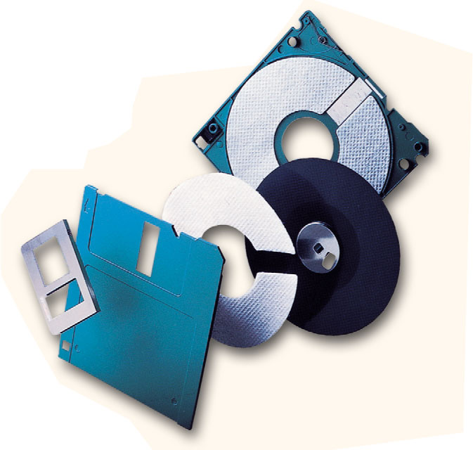
Floppy Disks
A floppy disk is a portable, inexpensive storage medium that consists of a thin, circular, flexible plastic disk with a magnetic coating enclosed in a square-shaped plastic shell.

Slide 186
Structure Of Floppy Disks
Initially Floppy disks were 8-inches wide, they then shrank to 5.25 inches, and today the most widely used folly disks are 3.5 inches wide and can typically store 1.44 megabytes of data.
A folly disk is a magnetic disk, which means that it used magnetic patterns to store data.
Data in floppy disks can be read from and written to.
Formatting is the process of preparing a disk for reading and writing.
A track is a narrow recording band that forms a full circle on the surface of the disk.

Slide 187
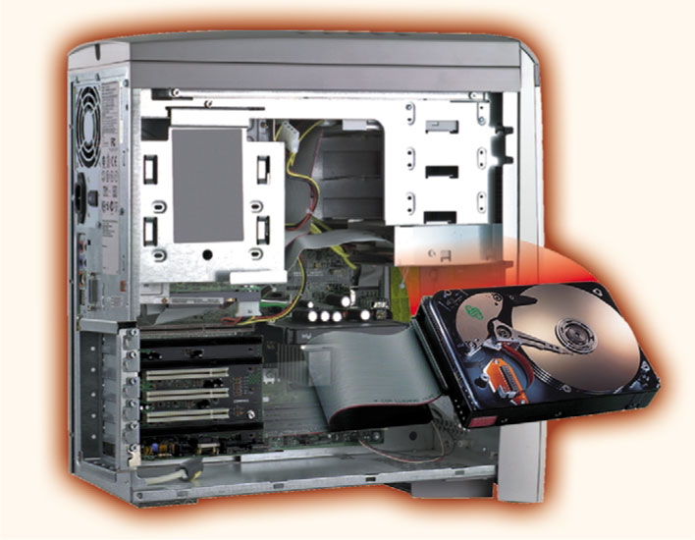
Hard Disks
Another form of auxiliary storage is a hard disk. A hard disk consists of one or more rigid metal plates coated with a metal oxide material that allows data to be magnetically recorded on the surface of the platters.
The hard disk platters spin at a high rate of speed, typically 5400 to 7200 revolutions per minute (RPM).
Storage capacities of hard disks for personal computers range from 10 GB to 120 GB (one billion bytes are called a gigabyte).

Slide 188
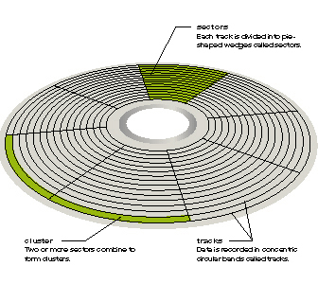
sectors
each track is divided into pie-shaped wedges
cluster
two or more sectors combined
tracks
data is recorded in concentric circular bands

Slide 189
Optical Mass Storage Devices
Store bit values as variations in light reflection
Higher areal density & longer data life than magnetic storage
Standardized and relatively inexpensive
Uses: read-only storage with low performance requirements, applications with high capacity requirements & where portability in a standardized format is needed

Slide 190
Optical Drives
CD's (Compact Disk)
~ 700 MB storage
CD-ROM (read only)
CD-R: (record) to a CD
CD-RW: can write and erase CD to reuse it (re-writable)
DVD(Digital Video Disk)

Slide 191
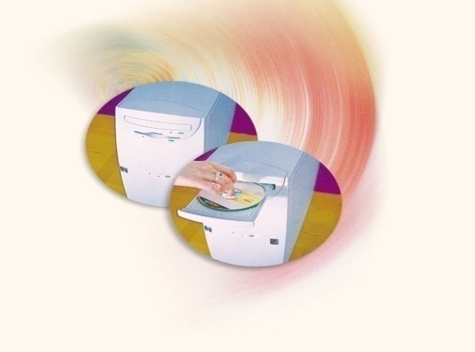
Compact Discs (CD)
A compact disk (CD), also called an optical disc, is a flat round, portable storage medium that is usually 4.75 inch in diameter.
A CD-ROM (read only memory), is a compact disc that used the same laser technology as audio CDs for recording music. In addition it can contain other types of data such as text, graphics, and video.
The capacity of a CD-ROM is 650 MB of data.

Slide 192
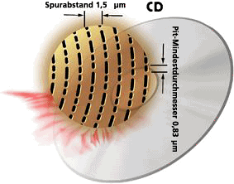
DVD (Digital Video Disk)
DVD-ROM
Over 4 GB storage (varies with format)
DVD- ROM (read only)
Many recordable formats (e.g., DVD-R, DVD-RW; ..)
Are more highly compact than a CD.
Special laser is needed to read them

Slide 193

Blu-ray Technology
Name
Derived from the blue-violet laser used to read and write data.
Developed by the Blu-ray Disc Association with more than 180 members.
Dell
Sony
LG

Slide 194
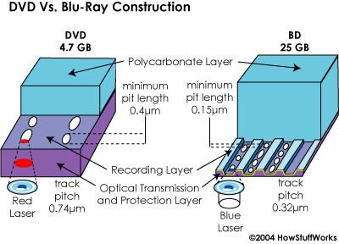
Blu-ray Technology Cont.
Data capacity
Because Blu-ray uses a blue laser(405 nanometers) instead of a red laser(650 nanometers) this allows the data tracks on the disc to be very compact.
This allows for more than twice as small pits as on a DVD.

Slide 195
Blu-ray Technology Cont.
Formats
BD-ROM (read-only) - for pre-recorded content
BD-R (recordable) - for PC data storage
BD-RW (rewritable) - for PC data storage
BD-RE (rewritable) - for HDTV recording

Slide 196
Summary
Introduction
RAM,ROM,PROM,EPROM
Auxiliary Storage Devices-Magnetic Tape, Hard Disk, Floppy Disk
Optical Disks: CD-R Drive,CD-RW disks,DVD,Blue ray Discs.

Slide 197
Here, we study computer organization
Structure: how computer components are connected together, how they communicate
Function: what these components do
We start with the most important component, the CPU (central processing unit or processor)
This is the brain of the computer, it does all the processing
The CPU is in charge of executing the current program
each program is stored in memory along with data
the CPU is in charge of retrieving the next instruction from memory (fetch), decoding and executing it (execution)
execution usually requires the use of one or more circuits in the ALU and temporary storage in registers
some instructions cause data movement (memory accesses, input, output) and some instructions change what the next instruction is (branches)
We divide the CPU into two areas
datapath – registers and ALU (the execution unit)
control unit – circuits in charge of performing the fetch-execute cycle
Notes:
As we covered in chapter 1, the basic process of the computer is the fetch-execute cycle. The Control Unit is programmed to perform this cycle. It issues commands to perform an instruction fetch (from memory to CPU), place the instruction in the instruction register, decode the instruction which comprises both determining what command will be issued (whether an arithmetic/logic operation, data movement, or condition and branch), fetch any operands (from memory or registers), execute the command, store the result (either to memory or registers) and determine if an interrupt has arisen during this cycle. We explore this in more detail later in this chapter.

Slide 198
Two Kinds of Registers
User registers
These store data and addresses (pointers to data)
These are manipulated by your program instructions
Example: Add R1, R2, R3
R1 ← R2 + R3
Computers will have between
1 and hundreds of registers
Possibly divided into data and address registers
Registers are usually the size of the computer’s word size
32 or 64 bits today, previously it had been 8 or 16 bits
Some machines use special-purpose registers
each register has an implied usage
Others have general-purpose registers
use them any way you want to
Control registers
Registers that store information used by the control unit to perform the fetch-execute cycle
PC – program counter – the memory location of the next instruction
IR – instruction register – the current instruction being executed
Status flags – information about the results of the last instruction executed (was there an overflow, was the result positive, zero or negative? Etc)
Stack Pointer – location in memory of the top of the run-time stack (used for procedure calls and returns)
Notes:
The typical notation for assembly instructions, like Add R1, R2, R3, is that the first operand listed is the destination and the next operands are the source. Some instructions use 2 operands instead, in which case the first operand is taken to be both destination and source. For instance, Add R1, R2 → R1 ← R1 + R2. Notice that these are destructive operations in that one operand is over-written. Some instructions use only 1 operand, in which case the other operand is implied to be a special purpose register like the accumulator (AC). Add X is taken to mean AC ← AC + X.

Slide 199
ALU and Control Unit
The ALU consists of circuits to perform arithmetic and logic operations
Adder
Multiplier
Shifter
Comparitor
Etc…
Operations in the ALU set status flags (carry, overflow, positive, zero, negative, etc)
Also, possibly, temporary registers before moving results back to register or memory
The control unit is in charge of managing the fetch-execute cycle
It sends out control signals to all other devices
A control signal indicates that the device should activate or perform it’s function
For instance:
Instruction fetching requires
sending the PC value to main memory
signaling memory to read
when the datum comes back from memory, move it to the IR
increment the PC to point to the next instruction
These operations are controlled by the control unit
Now the control unit decodes the instruction signals the proper ALU circuit(s) to execute it
Notes:
We visited the ALU circuits in chapter 3 (or most of them). Recall that all circuits in the ALU operate when passed in data. We use a MUX to select the proper device’s output to pass back along the bus and into a destination register. Also, the various circuits will send result info to the status flag (positve, negative or zero, carry, overflow).

Slide 200
The System Clock
In order to regulate when the control unit issues its control signals, computers use a system clock
At each clock pulse, the control unit goes on to the next task
Register values are loaded or stored at the beginning of a clock pulse
ALU circuits activate at the beginning of a clock pulse
Typical clock speeds are based on the amount of time it takes to perform one of these actions (register or ALU)
Clock performance is based on the number of pulses per second, or its Megahertz (or Gigahertz) rating
This is a misleading spec
The number of clock pulses (cycles) that it takes to execute one instruction differs from one computer to the next
Assume computer A takes 10 clock cycles per instruction but has a 1 Gigahertz clock speed
Assume computer B can execute 10 instructions in 11 cycles using a pipeline, but has a 250 Megahertz clock speed
Which one is faster? B even though its clock is slower!
Notes:
It may be surprising, but system clock speed does not equate to processor speed. There are many complicated factors that determine how fast a processor is. It was discovered in the late 80s that a pipeline will greatly increase processor speed, moreso than clock speed. So computer architects have been more focused on determining how to best provide parallelism both in terms of the ability to overlap instructions and in terms of offering extra hardware than on increasing clock speed. In fact, clock speed is not so much limited to any technological factor as it is limited by “what is the shortest operation available” because the system clock is often tuned to an operation. In RISC instruction sets, which we explore in chapter 5, we see that the system clock is often tuned to the time it takes to perform a cache access.

Slide 201
Comparing Clocks
It is difficult to compute CPU performance just by comparing clock speed
You must also consider how many clock cycles it takes to execute 1 instruction
How fast memory is
How fast the bus is
Etc
The book offers an example comparing 286 multiply to a pentium multiply
In addition, there are different clocks in the computer, the Control Unit and the whole CPU are governed by the system clock
There is usually a bus clock as well to regulate the usage of the slower buses
Notes:
We study measuring CPU performance in CSC 462/562 (Computer Architecture).

Slide 202
The Bus
System Bus connects the CPU to memory and I/O devices
A bus is a collection of wires that carries electrical current
The current is the information being passed between components
typically the information is a datum or program instruction, but can also include control signals and memory or I/O addresses
There are 3 parts to a bus
the data bus (for both data and program instructions)
the control bus (control signals from the Control Unit to devices, and feedback lines for acknowledging that the devices are ready or for interrupting the CPU)
address bus (the address of the memory location or I/O device that is to perform the given data movement operation)
Additionally, computers may have multiple buses
local bus – connects registers, ALU and control unit together (also an on-chip cache if there is one)
system bus – connects CPU to main memory
expansion or I/O bus – connects system bus to I/O devices
Notes:
The address bus is uni-directional, the CPU always sends out the address, no other devices will send an address. The control bus is bi-directional, the CPU sends out commands to memory (read/write) and I/O devices (input, output, possible fast forward, rewind, format) and requests (are you available?) and the devices can send responses (busy/available) and interrupts (calls for attention). Data bus is bi-directional – data is sent from the CPU to memory for a store command, from CPU to I/O for an output command, from memory to CPU for a load command, from I/O to CPU for an input.

Slide 203
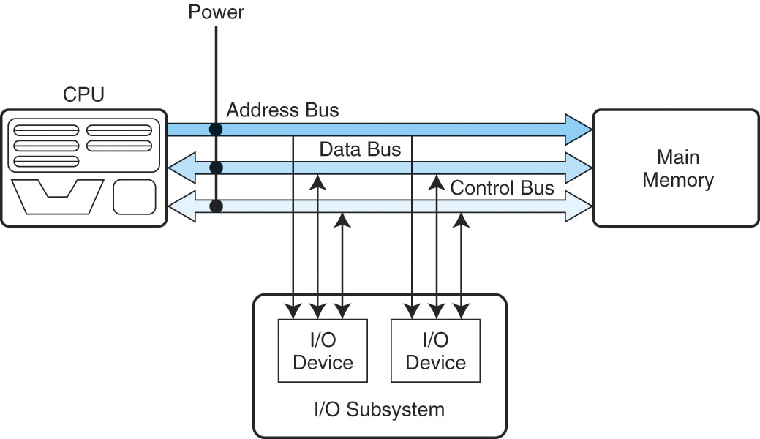
The System Bus
Here we see the system bus in more detail
The CPU connects to the bus through pins
The bus is on the motherboard inside the system unit
Main memory (a collection of chips) connects to this bus through pins
The I/O subsystem connects to this bus through the expansion bus
The bus carries three types of information
the address from the CPU of the intended item to be accessed
the control information (read versus write, or status information like “are you available?”)
the data, either being sent to the device, or from the device to CPU

Slide 204
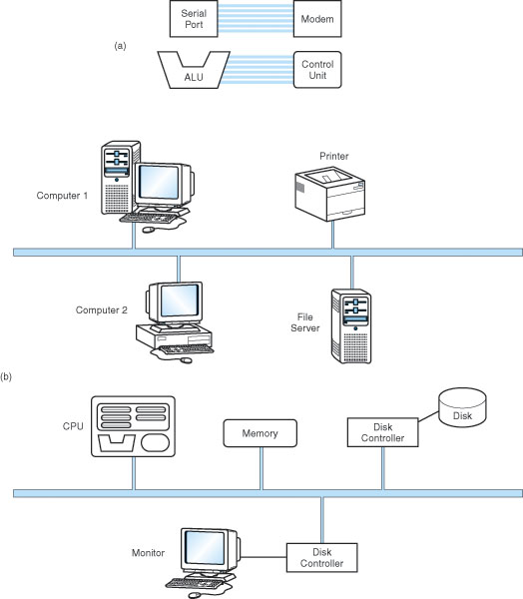
More on Buses
Buses connect two types of devices
Masters – those devices that can initiate requests (CPU, some I/O devices)
Slaves – those devices that only respond to requests from masters (memory, some I/O devices)
Some buses are dedicated
The bus directly connects two devices (point-to-point bus)
Most buses connect multiple components
Common pathway or multipoint
Point-to-point
Buses
Multipoint
network
Multipoint
Expansion bus
Notes:
This slide is not very important. The most important thing to get from it is that masters can initiate requests and that slaves only respond. Memory is a slave device, the CPU is a master device, and I/O devices are both. Few buses are point-to-point except within the CPU. The system bus connects to the expansion bus, and the expansion bus connects to the network, so you can think of a computer network as an extension to the expansion (I/O) bus.

Slide 205
Bus Interactions
Except for point-to-point buses, we have to worry about who gets to use the bus
Especially the expansion bus where multiple I/O devices may want to communicate between themselves and the CPU or memory at the same time – we need a form of bus arbitration
Daisy chain arbitration
each device has a bus request line on the control bus, when a device wants to use the bus, it places its request and the highest priority device is selected (this is an unfair approach)
Centralized parallel arbitration
the bus itself contains an arbiter (a processor) that decides – the arbiter might become a bottleneck, and this is also slightly more expensive
Distributed arbitration
the devices “vote” to determine who gets to use the bus, usually based on a priority scheme, again possibly unfair
Distributed arbitration using collision detection
it’s a free-for-all, but if a device detects that another device is using the bus, this device waits a short amount of time before trying again

Slide 206
I/O Subsystem
There are many different types of I/O devices, collectively known as the I/O Subsystem
Since I/O devices can vary greatly in their speed and usage, the CPU does not directly control these devices
Instead, I/O modules, or interfaces, take the CPU commands and pass them on to their I/O devices
One interface is in charge of one or more similar types of devices
Notes:
I/O interfaces contain registers and in some cases, memory buffers. So each of these is given its own address. In memory-mapped I/O, these addresses overlap those of memory so that a request issued to one of these memory addresses is actually a request of I/O, not memory and memory ignores the request. In such a system, the addresses are the earliest (say the first 5000 addresses). As an example, a disk interface might have these storage locations:
0: control register (bits for: the command, is the device available? did an interrupt arise? has the interrupt been acknowledged?)
1: address (what memory address will we be sending the datum to once it is loaded from disk?)
2: count (how many bytes/words will we transfer?)
3-1026: (1K worth of storage)
In isolated I/O, the 5000 or so addresses are separate from memory, so that we need an extra control line to indicate if the address is a memory address or an I/O address. In memory-mapped I/O, the early addresses are shared so that, if one of these addresses is sent out, memory ignores it.

Slide 207
I/O types
To communicate to the right I/O device, the CPU addresses the device through one of two forms
Memory-mapped I/O
the interface has its own memory which are addressed as if they were part of main memory, so that some memory locations are not used, they are instead registers in the I/O interfaces
Isolated I/O
the CPU differentiates memory addresses from I/O addresses by having additional control lines indicating whether an address is meant for memory or I/O

Slide 208
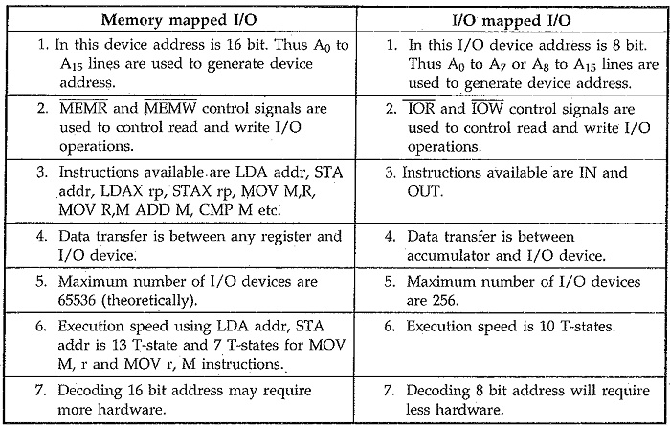

Slide 209
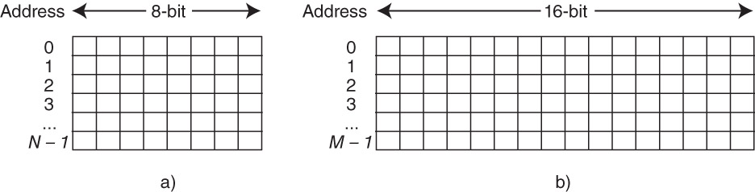
Memory Organization
Memory is organized into byte or word-sized blocks
Each block has a unique address
This can be envisioned as an array of cells, see the figure below
The CPU accesses memory by sending an address of the intended access and a control command to read or write
The memory module then responds to the request appropriately
A decoder is used to decode the binary address into a specific memory location
Notes:
We must differentiate between the size of memory and the number of addresses in memory. Computers may be
byte addressable, in which case every byte is its own address and therefore the two sizes are the same (size of memory in bytes, number of addresses)
word addressable, in which case a single memory address denotes a collection of bytes so that the two sizes differ
For instance, above on the right, we have a computer of M addresses where each address stored 16 bitrs (2 bytes), so that in fact the computer has a size of 2*M Bytes or M Words. When a computer is word addressable, we will have to translate memory sizes from bytes to words.
We will want to know the number of bits needed to specify an address. We need this to know the size of the address bus and also to know how big an address register needs to be. In most computers, we use 32 bit or 64 bit registers and buses. A 32 bit address is a decent size but today’s computers are beginning to require larger addresses.
To determine the number of bits per address, we use log ₂ number of addresses. If we are dealing with a byte addressable computer, then this is log ₂ memory size in bytes. If we are dealing with a word addressable computer, then this is log ₂ number of addresses. The number of addresses for a word addressable computer = memory size in bytes / number of bytes per word. The number of bytes per word is the word size / 8 bits (word size is usually given in bits, such as 32 bits).
Examples: We have a 4 GByte computer where the word size = 32 bits. If the computer is byte addressable, then there are 4 G memory locations and we need log ₂ 4G = 32 bits for an address. If the computer is word addressable, then there are 4 GByte / 4 bytes/word = 1 GWord and we need log ₂ 1G = 30 bits for an address.
What about a 32 GByte computer with word size = 64 bits?

Slide 210
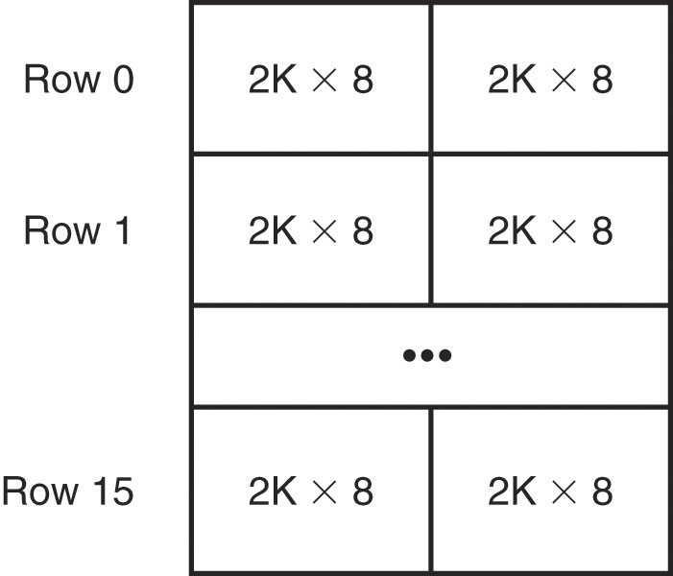
Dividing Memory Across Chips
Each memory chip can store a certain amount of information
However, architects decide how memory is spread across these chips
For instance, do we want to have an entire byte on a single chip, or spread a byte across 2 or more chips?
The figure to the right shows that each chip stores 2 Kbytes and with 16 rows and 2 columns of chips, we can store 64 Kbytes
Here, a word (16 bits) is stored in two chips in the same row
Notes:
We create our computer memories by spreading them across multiple RAM chips. In the above example, we use 32 2Kx8 chips to build a 64 KByte computer. One advantage to spreading memory over several chips is that it creates distinct memory banks (in the figure above, these are unfortunately called rows). We discuss the use of memory banks on the next slide.
We would assume that for the above example, the word size is 16 bits, that is, going across one complete row or address is 16 bits, spread across two chips. So for instance, in memory location 0, the first 8 bits are placed on one chip and the last 8 bits are placed on a second chip. We would also assume that the machine is word addressable (most computers are today). So for the above example of a 16-bit word addressable computer, there are a total of 32K addresses making up 64KByte. With 32K of addresses, we need log ₂ 32K = 15 address bits. Now further notice that each chip stores 2K addresses of the 32K. There are 16 banks. Out of the 15 address bits, 11 of them are used on the chip to denote the specific address for that chip (actually, for that pair of chips, so its more accurate to say that the 11 bits denote the specific address for that bank). What about the other 4 bits? They are used to denote the bank number (4 bits lets us address 16 banks).
Assume instead that we have 16GBytes where each chip stores 128Mx8, and the machine is word addressable with a word size of 32 bits. How many chips are there? How many banks are there? How many bits does it take to make an address? Of those bits, how many are used for the address on the bank and how many to select the bank?
Before we compute the number of chips, we have to convert memory size to size in words. 16GB of 32-bit words = 16GB / 4 bytes/word = 4GWords (32 bits = 4 words, so we divided 16GB by 4). This makes memory 4Gx32.
To compute the number of chips, divide the size of memory by the size of a chip. The chip size, 128Mx8 means 128M addresses of 8 bits each. We get 4Gx32 / 128Mx8 = 32*4 = 128 chips. The number of banks is 128 chips / (32 / 8) = 32 banks. The size of an address is log ₂ 4G = 32. Of the 32 bits, we need log ₂ 32 = 5 bits for the bank select, leaving 32 – 5 = 27 bits for the address sent to the bank. Note that 2^27 = 128M, which means that we did this correctly in that each bank stores 128M addresses.

Slide 211
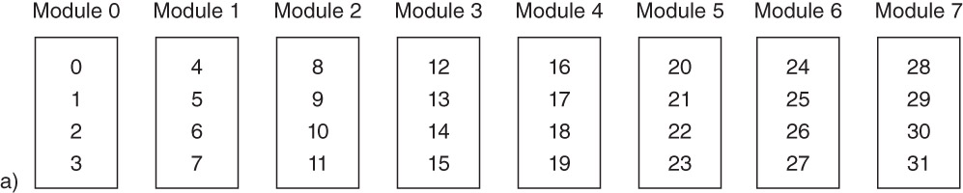
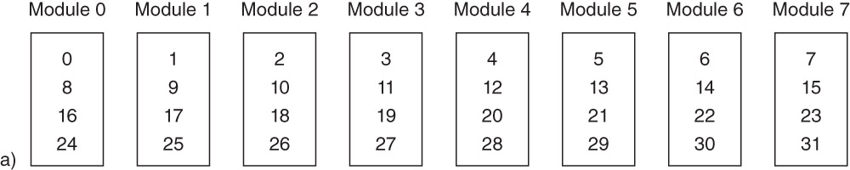
Interleaving Memory
Using high-order interleave, the address is broken into the chip followed by the location on the chip, giving a layout as shown above
The advantage of high-order interleave is that two different devices, working on two different areas of memory, can perform their memory accesses simultaneously
e.g., one device accesses address 5 and another accesses 31
In low-order interleave, the address is broken up by location on the chip first, and the chip number last
Consecutive memory locations are on consecutive chips
The advantage of lower-order interleave is that several consecutive memory accesses can be performed simultaneously
For instance, fetching 4 consecutive instructions at one time
Notes:
You can see the pattern of interleaving addresses across banks (here referred to as modules for some reason). Notice that in this above example, they erroneously start the modules at 1 instead of numbering them 0-7. Lets assume that in fact Module 1 refers to Bank 0 and Module 8 refers to Bank 7.
In the above computer, we have 32 total memory locations (we will assume to match the figure that each memory location is placed on a single chip). Thus, we need log ₂ 32 = 5 bits for any address. With 8 banks, we need log ₂ 8 = 3 bits for a bank and that leaves 2 bits for the address on a bank (and this is confirmed by seeing that every bank stores 4 different addresses). Lets further assume that we want to track down memory location 13 = 01101 in binary. In high-order interleave, the bank number is the first set of bits (in this case, the left-most 3 bits) and the address on the bank is the last set of bits (in this case, the right-most 2 bits). So address 13 should be on bank 011 and location 01. Recall that Bank 3 will really be Module 4. So look at Module 4 above in position 1 (the top position is location 0) and you will see 13. In low-order interleave, the bank number is the last set of numbers. For this example then, we will find location 13 at location 01 of bank 101 (bank 5 is Module 6). Look at module 6 position 1 and you will find 13!
Now notice that for high-order interleave, successive memory locations are located on the same bank. Assume that our memory is connected to multiple buses (for instance, memory connects to the CPU over the system bus and to I/O devices over the expansion bus). Since the CPU and an I/O device will most likely be referencing different processes (or perhaps the same process, but different parts of it), then high order interleave makes it likely that the devices will want to communicate with different parts of memory. A single memory bank can only respond to a single access at a time, but if two devices were contacting different banks, then both banks could potentially respond simultaneously. This is the advantage of high-order interleave.
Low-order interleave supports a different idea. Notice in low-order interleave that successive memory locations are stored on separate banks. Many high performance processors will request not just a single item from memory, but its successors too (a look-ahead fetch for instance). Instead of making the processor wait for 4 consecutive memory accesses, which is slow, all 4 accesses can occur simultaneously and then be shipped back to the CPU over the bus in 4 transfers. Since the bus transfer is faster than the memory access, a CPU can request one item and while processing it, 3 more of its neighbors could be on the way for the next few cycles.
Some computers will use low-order interleave and some use high-order depending on which form of parallelism is felt to be more warranted.

Slide 212
Interrupts
The last part of our computer organization is an interrupting mechanism
Left to itself, the CPU performs the fetch-execute cycle on your program repeatedly without pause, until the program terminates
What happens if an I/O device needs attention?
What happens if your program tries to do an illegal operation?
see the list on page 157 of types of illegal operations
What happens if you want to run 2 or more programs in a multitasking mode?
You cannot do this without interrupts
An interrupt is literally the interruption of the CPU so that it can switch its attention from your program to something else
an I/O device, the operating system, or another user program

Slide 213
The Interrupt Process
At the end of each fetch-execute cycle, the CPU checks to see if an interrupt has arisen
Devices send interrupts to the CPU over the control bus
If the instruction causes an interrupt, the Interrupt Flag (in the status flags) is set
If an interrupt has arisen, the interrupt is handled as follows
The CPU saves what it was doing (PC and other important registers are saved to the run-time stack in memory)
The CPU figures out who raised the interrupt and executes an interrupt handler to handle that type of interrupt
The interrupt handler is a set of code (part of the OS) stored in memory
While the interrupt is being handled, the CPU may choose to ignore or disable interrupts from interrupting the interrupt handler (known as a maskable interrupt) or may choose to handle a future interrupt (non-maskable interrupt)
Once the interrupt has been handled, the CPU restores the interrupted program by retrieving the values from the run-time stack
Notes:
Note that while a device may raise an interrupt at any time, an interrupt of the CPU will only be processed at the end of a fetch-execute cycle. Thus, an instruction cannot be interrupted although a program can be.
What information does the CPU save? Since the CPU must resume the process at the next instruction, it saves the PC (which has already been incremented to point at the next instruction). The status flags need to also be saved, as is the stack pointer register, which points to the program’s run-time stack (not to be confused with the operating system’s run-time stack mentioned in the slide above). The accumulator or other data registers may also be saved.
Some high-performance computers use two sets of registers so that an interrupt does not require saving the process information (registers) to a run-time stack in memory. Instead, these values are moved into a second set of registers and then these values are moved back into the original registers when the interrupt is over. Since the extra set of registers is more expensive, this is limited to high-performance computers only. Also, we still may need to use the run-time stack if an interrupt arises while we are handling the interrupt. We discuss how interrupts are handled in more detail in chapter 7.

Slide 214
Fetch-Execute Cycle Revisited
Recall that the control unit causes the fetch-execute cycle to be performed
How is the fetch process carried out?
Once an instruction is fetched, it is decoded and executed, how?
To answer these questions, we must implement the control unit
Control units are implemented either in a hardwired form or by microprogramming
Hardwired – each operation including the execution of every machine instruction uses a decoder to translate the op code into control sequences (such as move PC to MAR, signal memory read, move MBR to IR, increment PC)
This decoder can be extremely complicated, as you might expect, as every instruction must be converted directly into control signals
Microprogrammed – a ROM is used to store microprograms, one for each machine instruction

Slide 215
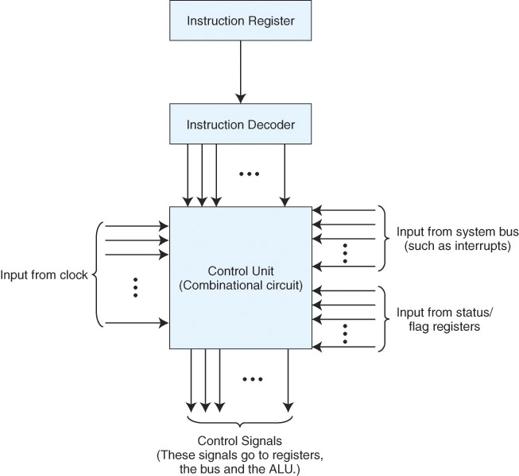
Hardwired Control Unit
The hardwired control unit is one
big circuit
Input is the instruction from the IR,
status flags and the system clock
and output are the control signals to
the registers and other devices
Notes:
The idea behind a hardwired control unit is that it is a big decoder. It receives the particular step of the fetch execute cycle that we are on (for instance, in clock cycle 0, we are doing PC ← MAR, in clock cycle 3 we are signaling a read from memory, in clock cycle 5 we are doing MAR ← IR[11..0], etc) If we are doing part of the fetch, then it will always be the same, so the signal to move PC ←MAR is always given if we are on clock cycle 0, and PC ← PC + 1 is always given if we are on clock cycle 2.
For MAR ← IR[11..0], we must first inspect the IR. If the op code is one that requires an operand (op code = 1, 2, 3, 4, 9, 11, 12) and we are in clock cycle 5, then we signal this operation.
For the execute phase, each instruction has between 1 and 5 (JnS) actual operations during the execute phase. For instance, AC ← AC + MBR is signaled if and only if we are in clock cycle 6 and the op code = 3 OR we are in clock cycle 8 and the op code = 11 (ADDI), and AC ← AC – MBR is signaled if and only if we are in clock cycle 6 and the op code = 4. The control unit’s combinational circuit is very complex even for the 13 instruction MARIE. The advantage is that the CPU is able to execute all phases of the fetch-execute cycle very quickly.

Slide 216
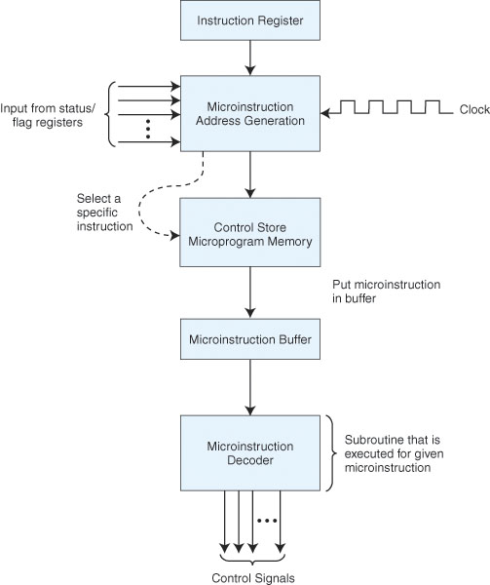
Microprogrammed Control Unit
The control store is a ROM that
stores all of the microprograms
One microprogram per fetch-execute
stage, and one per instruction in the
instruction set
Receive an instruction in IR
Start the microprogram, generating
the address, fetching the instruction
from the ROM and moving it to the
microinstruction buffer to be
decoded an executed
This process is much more time
consuming than the hardwired
unit, but is easier to implement
and more flexible
Notes:
Here, the steps for each instruction are broken into miniprograms called mircoprograms. For instance, the ADD operation has these microinstructions:
MAR ← X
MBR ← M[MAR]
AC ← AC + MBR
All 13 instructions share the same fetch/decode microprograms. So, MARIE would have a total of 16 microprograms, one for fetch, one for decode, one for each of the 13 instructions, and one for interrupts. A real computer would probably have hundreds of separate microprograms. All of these microprograms are stored, microinstruction by microinstruction, in the control store (ROM memory). We use a micro-fetch-execute cycle by generating the address of the next microinstruction using the microinstruction address generator, fetching the microinstruction and moving it into the microinstruction buffer where it is then executed. To save space, we encode our instructions and use a microinstruction buffer to decode it. This is all very complex stuff so we are going to skip over any more details. We cover this in a little more detail in 462/562.
An example of MARIE’s control store is given on the next slide.

Slide 217
CISC vs. RISC
Complex (CISC)
Microprogrammed control unit
Large number of instructions (200-500)
Instructions can do more than 1 thing (that is, an instruction could carry out 2 or more actions)
Many addressing modes
Instructions vary in length and format
This was the typical form of architecture until the mid 1980s, RISC has become more popular since then although most architectures remain CISC
Reduced (RISC)
Hardwired control unit
Instruction set limited (perhaps 80-100 instructions)
Instructions rely mostly on registers, memory accessed only on loads and stores
Few addressing modes
Instruction lengths fixed (usually 32 bits long)
Easy to pipeline for great speedup in performance

Slide 218
Interrupt
Interrupt is a signal emitted by hardware or software when a process or an event needs immediate attention. It alerts the processor to a high priority process requiring interruption of the current working process. In I/O devices one of the bus control lines is dedicated for this purpose and is called the Interrupt Service Routine (ISR).

Slide 219
Working
When a device raises an interrupt at lets say process i, the processor first completes the execution of instruction i. Then it loads the Program Counter (PC) with the address of the first instruction of the ISR. Before loading the Program Counter with the address, the address of the interrupted instruction is moved to a temporary location. Therefore, after handling the interrupt the processor can continue with process i+1.

Slide 220
While the processor is handling the interrupts, it must inform the device that its request has been recognized so that it stops sending the interrupt request signal. Also, saving the registers so that the interrupted process can be restored in the future, increases the delay between the time an interrupt is received and the start of the execution of the ISR. This is called Interrupt Lattency.

Slide 221
Hardware Interrupt
In a hardware interrupt, all the devices are connected to the Interrupt Request Line. A single request line is used for all the n devices. To request an interrupt, a device closes its associated switch. When a device requests an interrupts, the value of INTR is the logical OR of the requests from individual devices.

Slide 222
Sequence of events involved in handling an IRQ
Devices raise an IRQ.
Processor interrupts the program currently being executed.
Device is informed that its request has been recognized and the device deactivates the request signal.
The requested action is performed.
Interrupt is enabled and the interrupted program is resumed.

Slide 223
Handling Multiple Devices:
When more than one device raises an interrupt request signal, then additional information is needed to decide which which device to be considered first. The following methods are used to decide which device to select: Polling, Vectored Interrupts, and Interrupt Nesting. These are explained as following below.

Slide 224
Polling: In polling, the first device encountered with with IRQ bit set is the device that is to be serviced first. Appropriate ISR is called to service the same. It is easy to implement but a lot of time is wasted by interrogating the IRQ bit of all devices.

Slide 225
Vectored Interrupts: In vectored interrupts, a device requesting an interrupt identifies itself directly by sending a special code to the processor over the bus. This enables the processor to identify the device that generated the interrupt. The special code can be the starting address of the ISR or where the ISR is located in memory, and is called the interrupt vector.

Slide 226
Interrupt Nesting: In this method, I/O device is organized in a priority structure. Therefore, interrupt request from a higher priority device is recognized where as request from a lower priority device is not. To implement this each process/device (even the processor). Processor accepts interrupts only from devices/processes having priority more than it.

Slide 227
Processors priority is encoded in a few bits of PS (Process Status register). It can be changed by program instructions that write into the PS. Processor is in supervised mode only while executing OS routines. It switches to user mode before executing application programs.

Slide 228
Cache Memory
It is a special very high-speed memory. It is used to speed up and synchronizing with high-speed CPU. Cache memory is costlier than main memory or disk memory but economical than CPU registers. Cache memory is an extremely fast memory type that acts as a buffer between RAM and the CPU. It holds frequently requested data and instructions so that they are immediately available to the CPU when needed.

Slide 229
Cache memory is used to reduce the average time to access data from the Main memory. The cache is a smaller and faster memory which stores copies of the data from frequently used main memory locations. There are various different independent caches in a CPU, which store instructions and data.

Slide 230
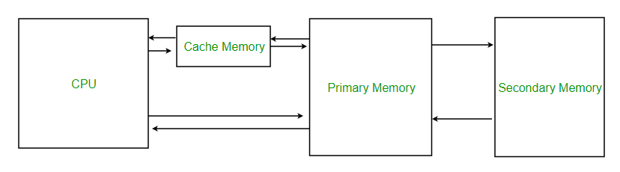
Cache Memory

Slide 231
Level 1 or Register – It is a type of memory in which data is stored and accepted that are immediately stored in CPU. Most commonly used register is accumulator, Program counter, address register etc.
Level 2 or Cache memory – It is the fastest memory which has faster access time where data is temporarily stored for faster access.

Slide 232
Level 3 or Main Memory – It is memory on which computer works currently. It is small in size and once power is off data no longer stays in this memory.
Level 4 or Secondary Memory – It is external memory which is not as fast as main memory but data stays permanently in this memory.

Slide 233
Cache Performance:
When the processor needs to read or write a location in main memory, it first checks for a corresponding entry in the cache.

Slide 234
If the processor finds that the memory location is in the cache, a cache hit has occurred and data is read from cache
If the processor does not find the memory location in the cache, a cache miss has occurred. For a cache miss, the cache allocates a new entry and copies in data from main memory, then the request is fulfilled from the contents of the cache.

Slide 235
The performance of cache memory is frequently measured in terms of a quantity called Hit ratio.
Hit ratio = hit / (hit + miss) = no. of hits/total accesses

Slide 236
Cache Mapping
There are three different types of mapping used for the purpose of cache memory which are as follows: Direct mapping, Associative mapping, and Set-Associative mapping. These are explained below.

Slide 237
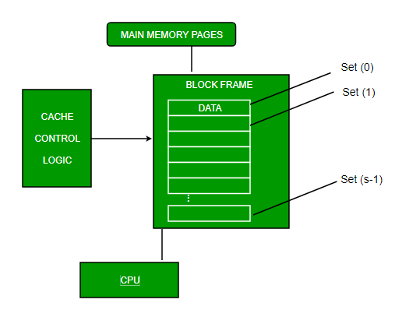
Direct Mapping

Slide 238
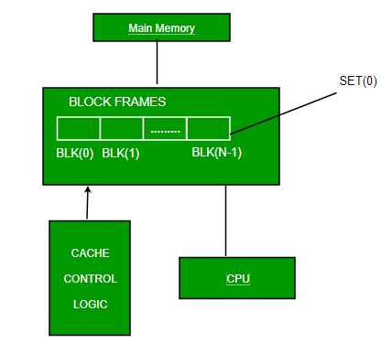
Associative Mapping

Slide 239
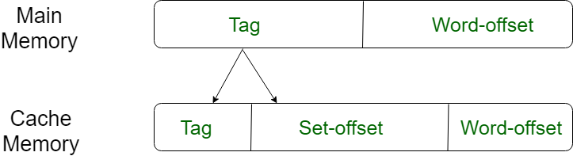

Slide 240
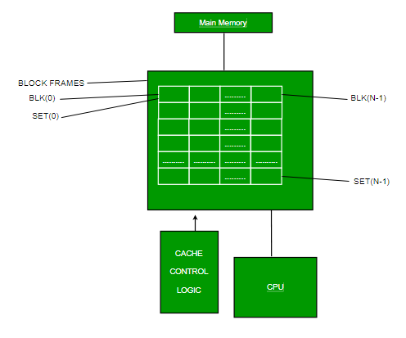
Set-associative Mapping

Slide 241
Application of Cache Memory
Usually, the cache memory can store a reasonable number of blocks at any given time, but this number is small compared to the total number of blocks in the main memory.
The correspondence between the main memory blocks and those in the cache is specified by a mapping function.

Slide 242
Types of Cache
Primary Cache A primary cache is always located on the processor chip. This cache is small and its access time is comparable to that of processor registers.
Secondary Cache Secondary cache is placed between the primary cache and the rest of the memory. It is referred to as the level 2 (L2) cache. Often, the Level 2 cache is also housed on the processor chip.

Slide 243
Locality of reference
Since size of cache memory is less as compared to main memory. So to check which part of main memory should be given priority and loaded in cache is decided based on locality of reference.

Slide 244
Types of Locality of reference
Spatial Locality of reference This says that there is a chance that element will be present in the close proximity to the reference point and next time if again searched then more close proximity to the point of reference.

Slide 245
Temporal Locality of reference In this Least recently used algorithm will be used. Whenever there is page fault occurs within a word will not only load word in main memory but complete page fault will be loaded because spatial locality of reference rule says that if you are referring any word next word will be referred in its register that’s why we load complete page table so the complete block will be loaded.

